Slide 1
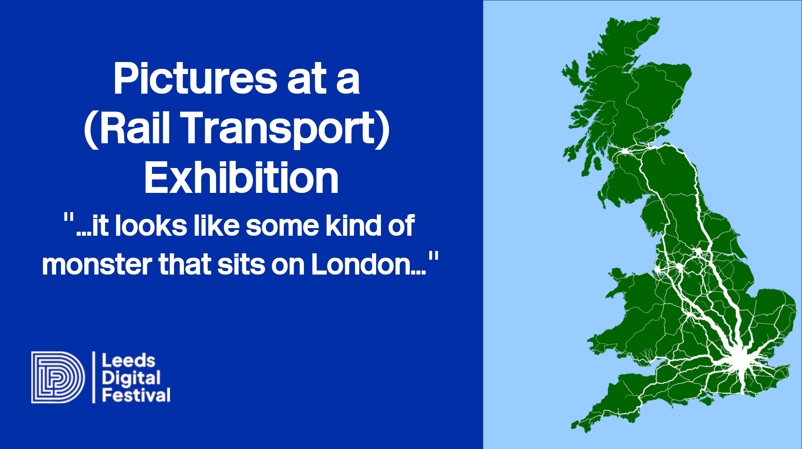
Notes:
1

Slide 2
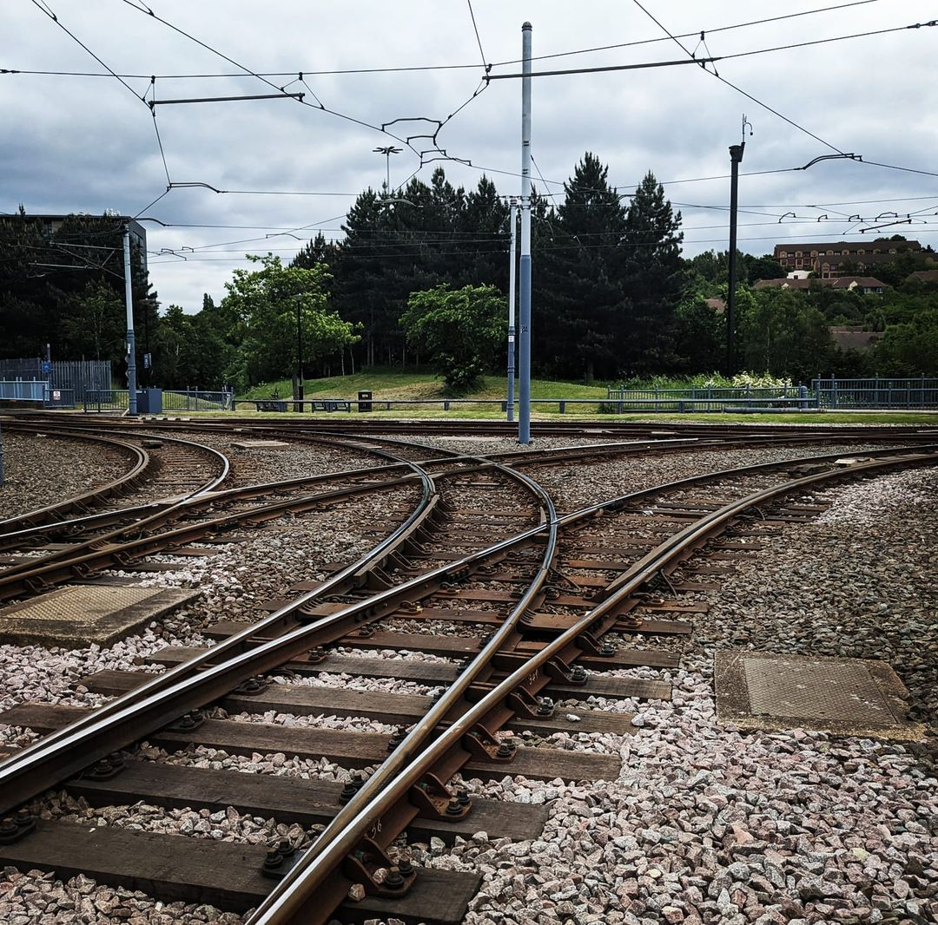
Pictures at a (Rail Transport) Exhibition
In 2023 UK Office of Road and Rail published a new dataset that allows anyone to explore almost 1 billion journeys from every one of its more than 2,580 train stations in Great Britain, and updated this to include all journeys from 2018 to 2023
This talk looks at using this data along with other open datasets to host a visualisation for each station, and an aggregated view of rail travel in Britain, also known as the ‘monster over London’
Notes:
2

Slide 3


Introduction
Notes:
Technical IT architect working in the UK rail industry
Never worked in the railway outside of IT
Verisimilitude the appearance of being true or real.
This is my operations take
3

Slide 4

@wnd@fosstodon.org X/Twitter @WillDeakin1
Will Deakin
With 25-years of being paid to work with technology, by day I am the Network Rail Trains Portfolio Architect and European Infrastructure Manager speaker at the European Agency for Railways data assurance board
At night I use data science™ to think about things like where people go on trains

Slide 5




You may also know me from...
COM3523 Software Re-engineering
INF4000 Data Visualisation
INF4001 Information Visualisation for Decision Making
TRAN5340M Transport Data Science
Notes:
5

Slide 6
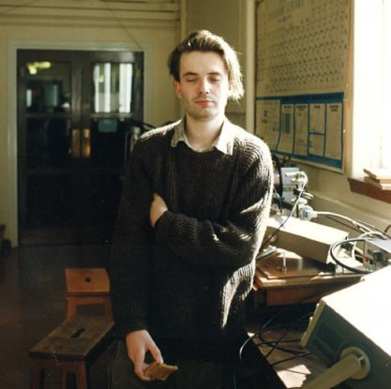
Where did it
all begin?

Slide 7

Background
Notes:
7

Slide 8
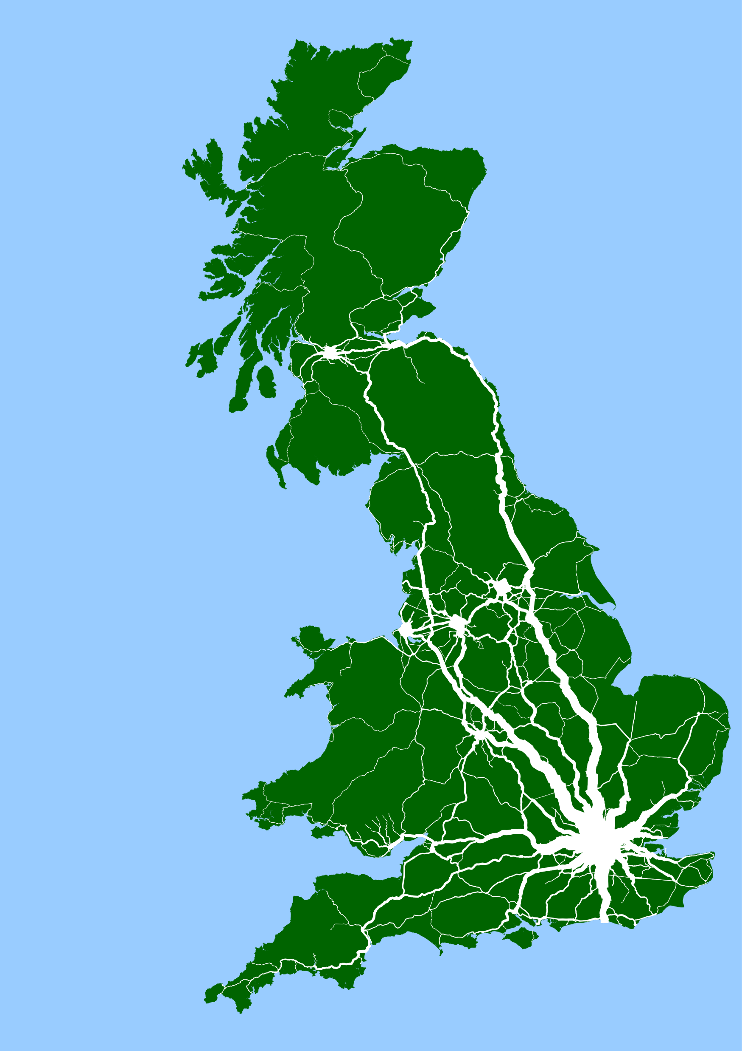
Background
“Over a weekend Deakin collected several open datasets about travel on the national rail network and combined them into a series of some 2,500 maps, one for every rail station, depicting 894 million journeys. The width of each line shows the frequency of travel between two points. So the result shows a rough approximation of how millions of people used the country’s near 10,000 miles (16,000 kilometers) of track in the 2021-2022 financial year.”

Slide 9

Parasocial
Activities
Notes:
9

Slide 10
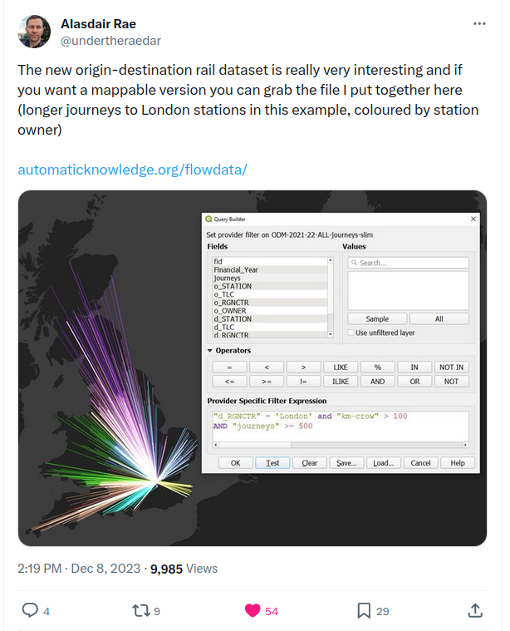
The Big Boys Made
Me Do It!
Social Media Inspired projects
The National Electronic Sectional Appendix (NESA) PDF loading-gauge tables into a spreadsheet
30GB of Microsoft inferred CSV road location data to a map
Let me tell you about this spherical cow.

Slide 11
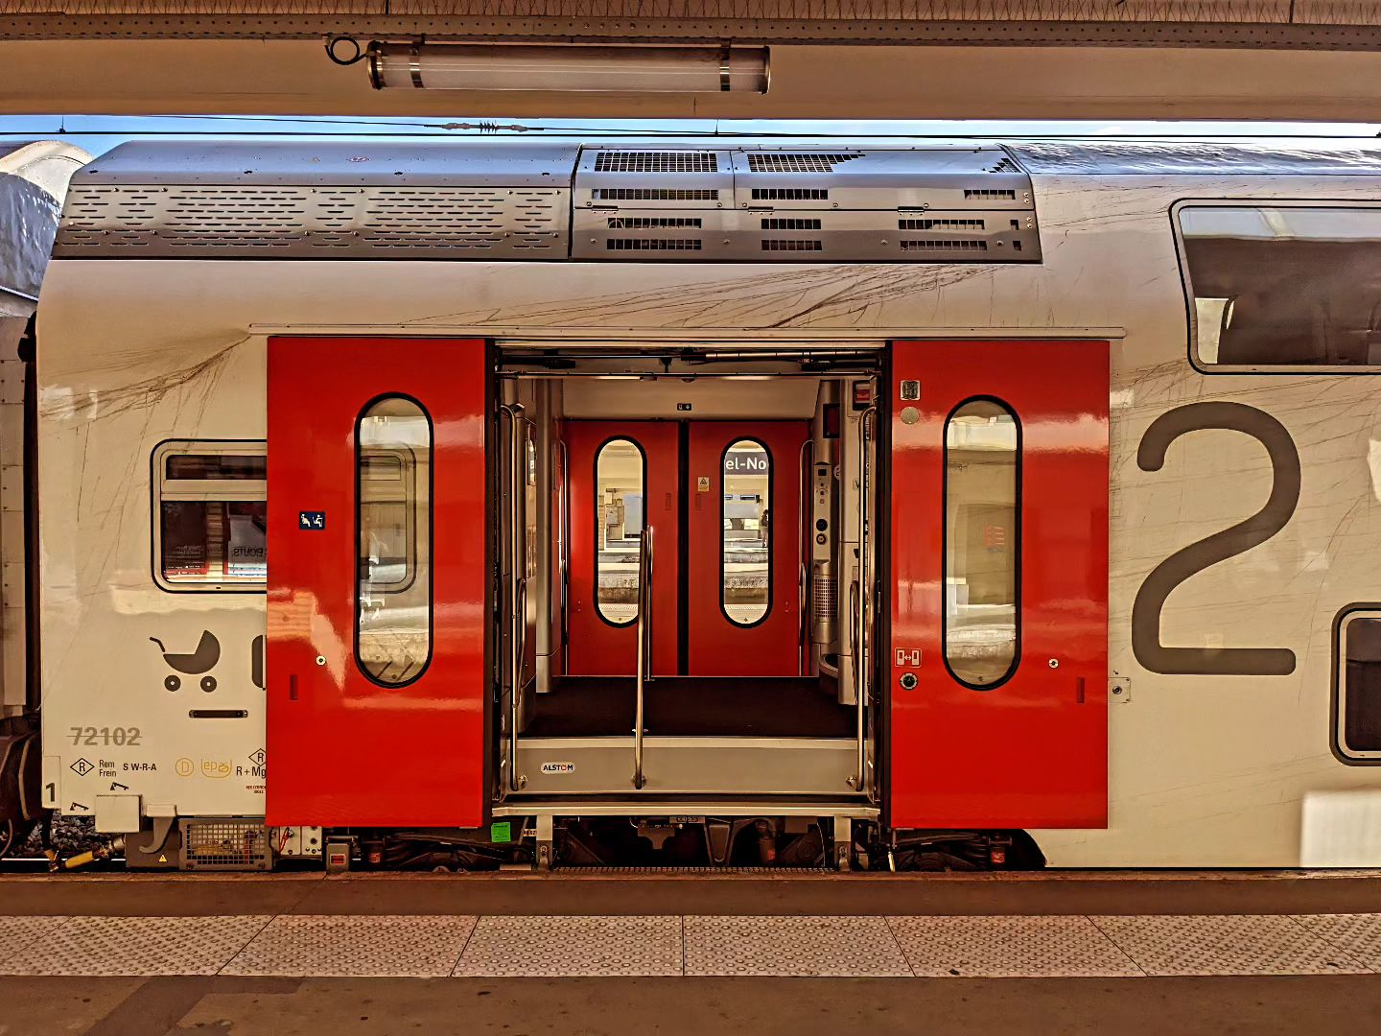
Parasocial
Activities II
Notes:
11

Slide 12
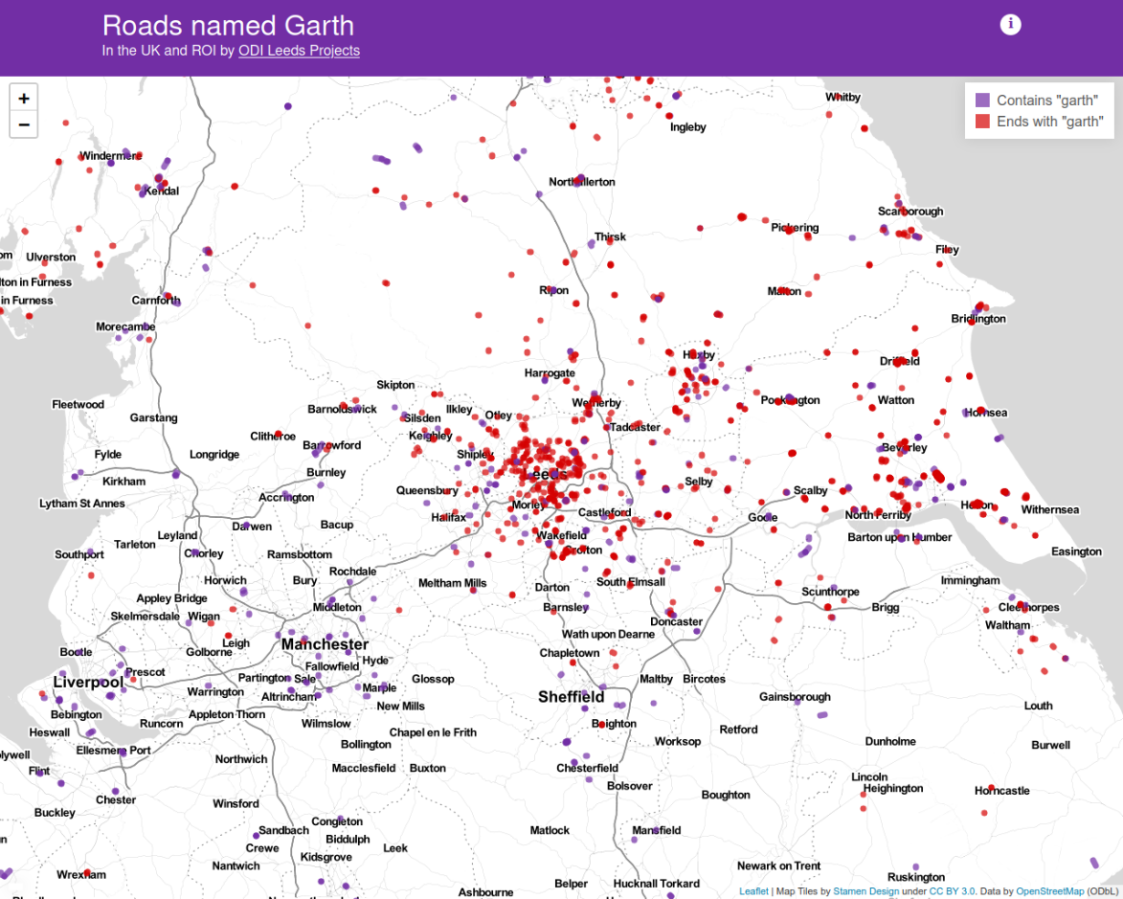
The Garthiness of Leeds
‘It turns out Leeds is a bit of a Garth hotspot and their distribution generally correlates with regions settled by the Vikings around 1000 years ago.
Party on!’
Stuart, ODI Leeds

Slide 13
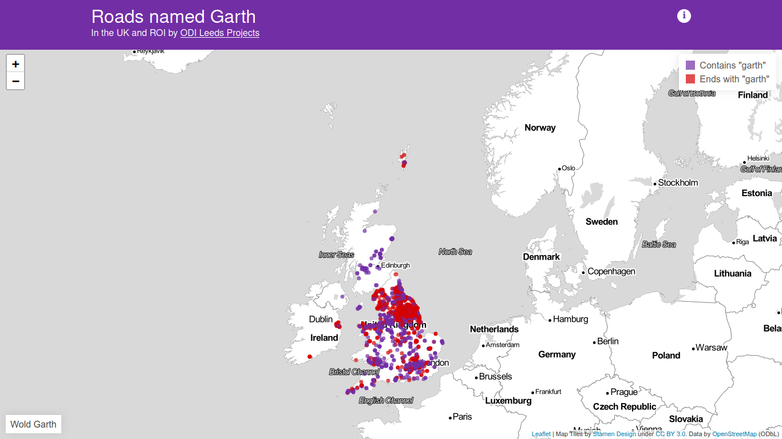
Hiraeth of Irfon Valley C.P. School
Hiraeth: a mixture of longing, yearning, nostalgia, wistfulness or an earnest desire for the Wales of the past

Slide 14
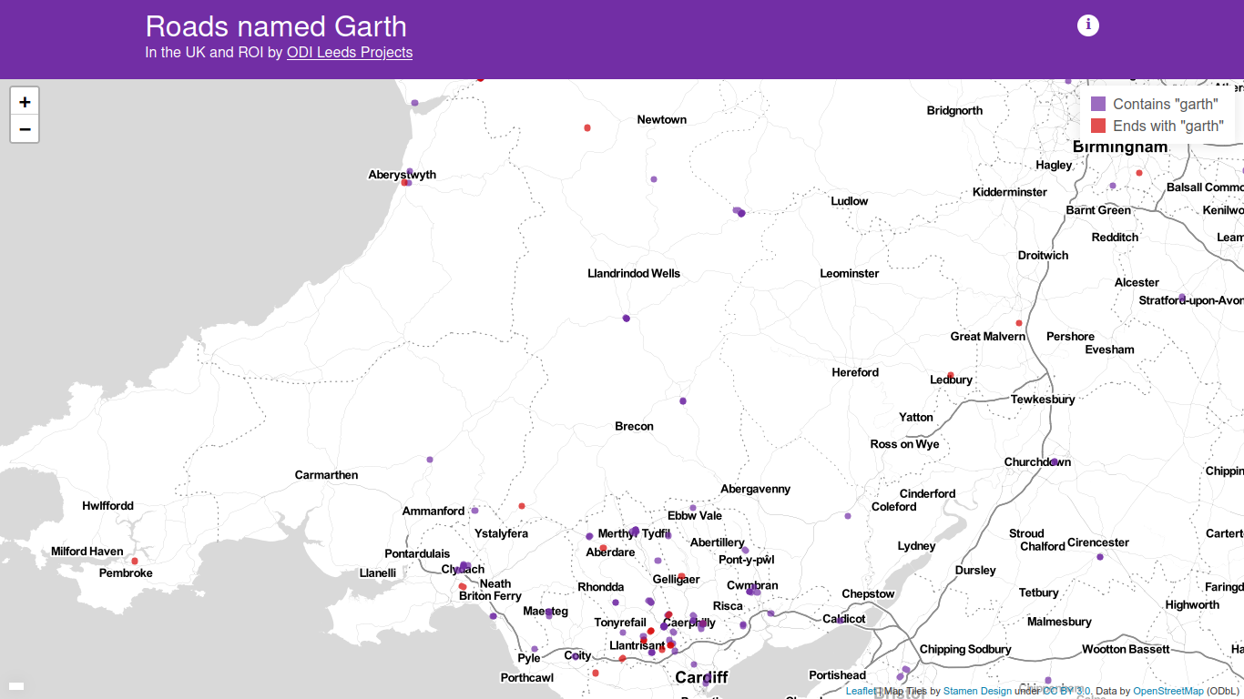
Party On!
But where was Garth?

Slide 15
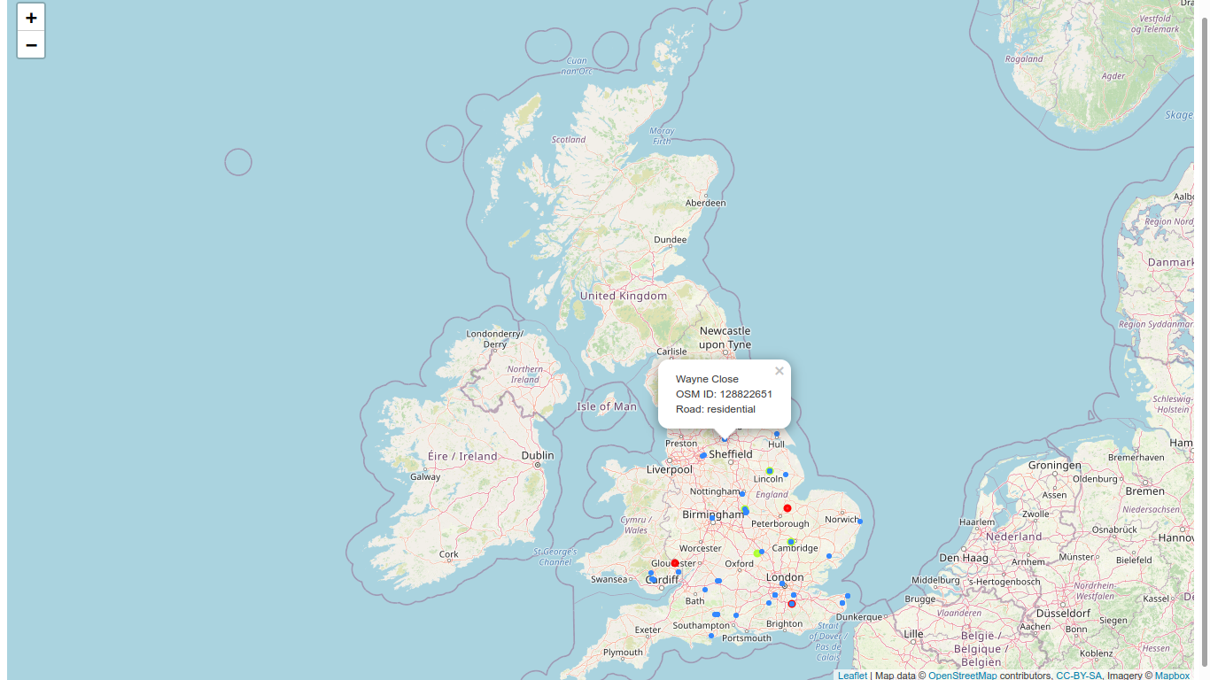
British Map of Wayne!
British Wayne

Slide 16
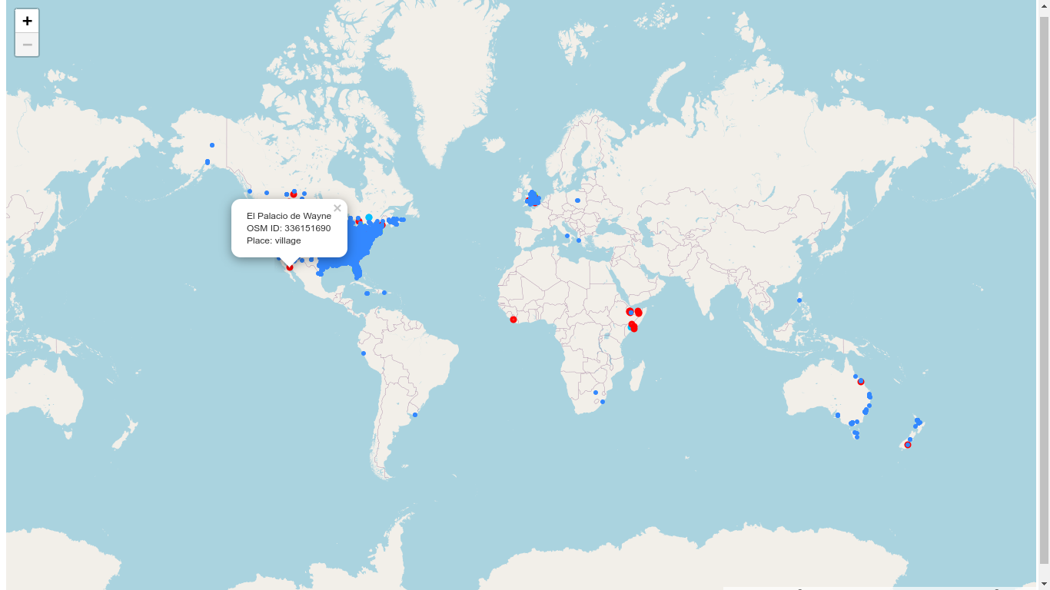
The Global Map of Wayne!
‘In tribute to the work of the Open Data Institute Leeds I bring you global mapping of Wayne, or as it were, Wayne’s World’
Excellent! Excellent!

Slide 17
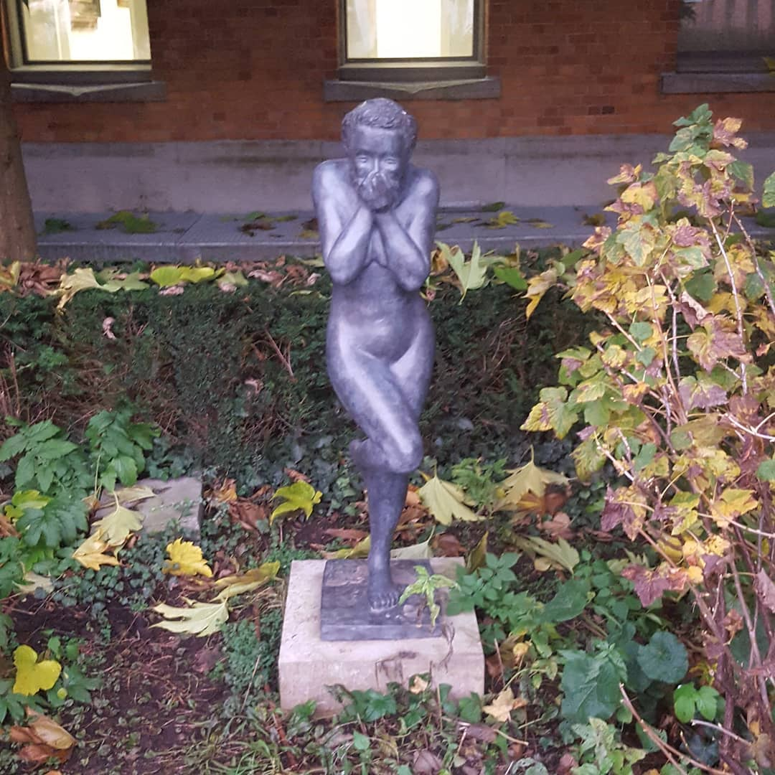

Slide 18
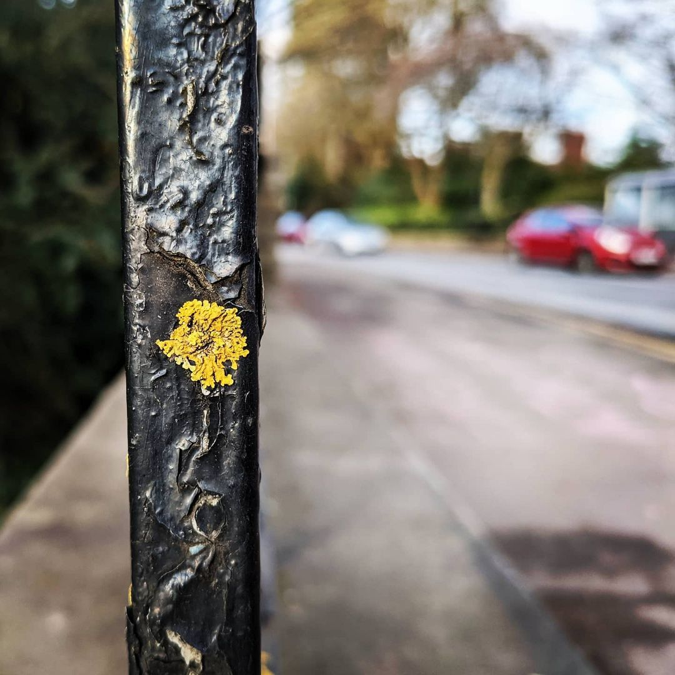
Spanning
the
Genres
Notes:
18

Slide 19
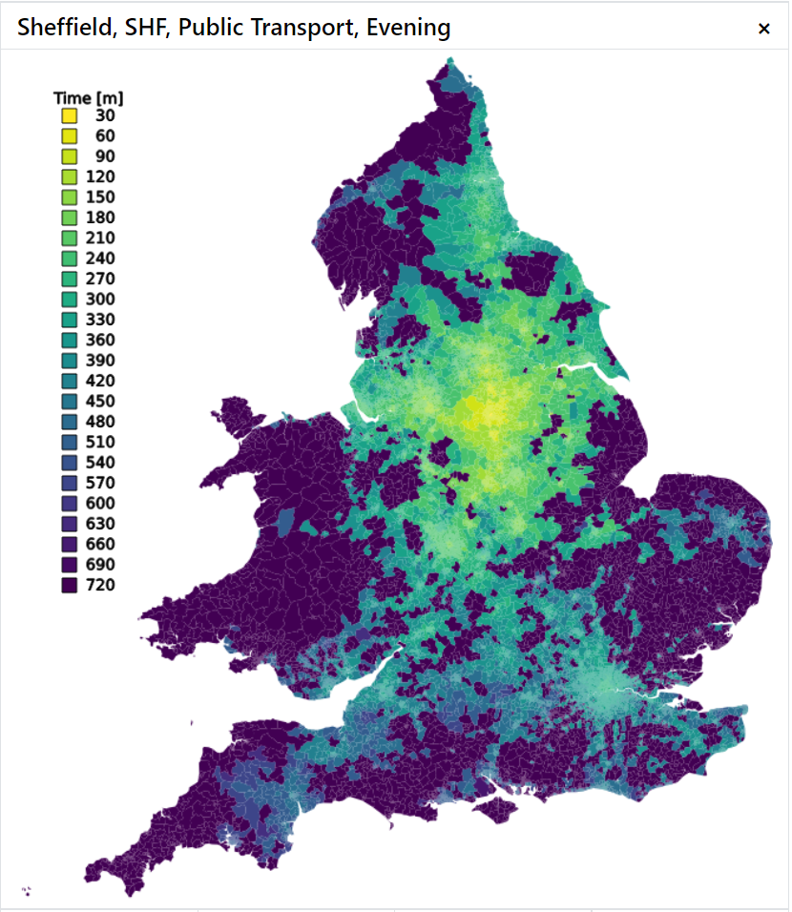
Public Transport Travel
Department for Transport (DfT) 2001/2011 travel-time cloropleths for train-station public transport for England and Wales
Office for National Statistics (ONS) Lower Layer Super Output Areas (LSOA) geography
Notes:
19

Slide 20

Where my Railway Goes
Using 2011 Census data
station-location data from National Passenger Transport Access Node (NaPTAN)
Super Output Area (SOA) population data
Middle MSOA travel data
Notes:
20

Slide 21
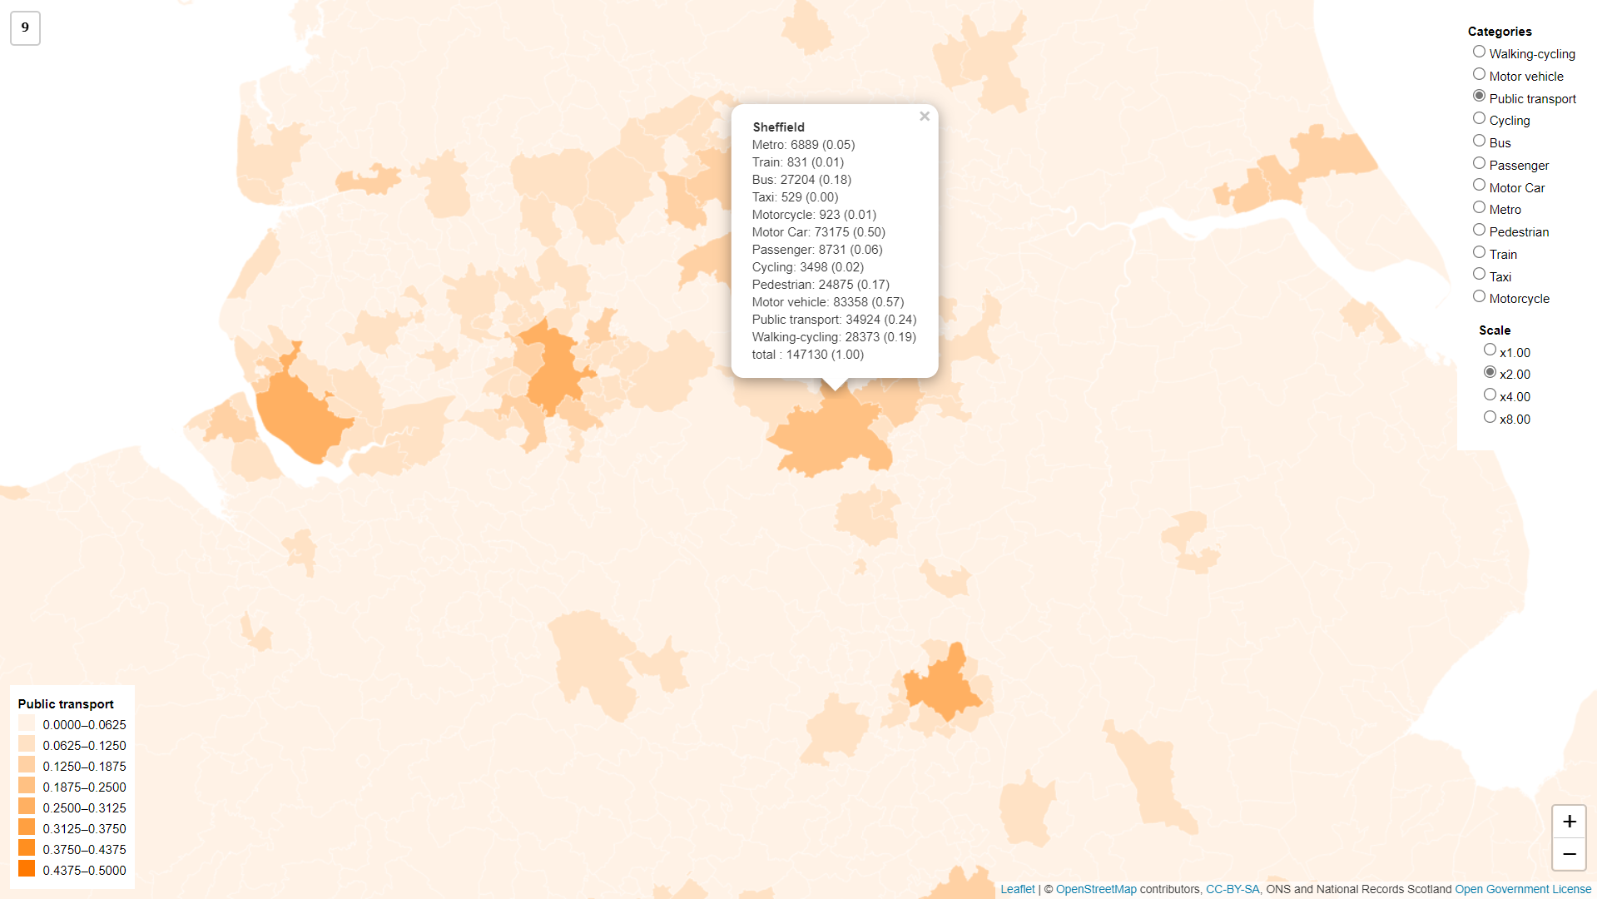
Notes:
If I want to build a passenger network I know where I could start with census data
21

Slide 22
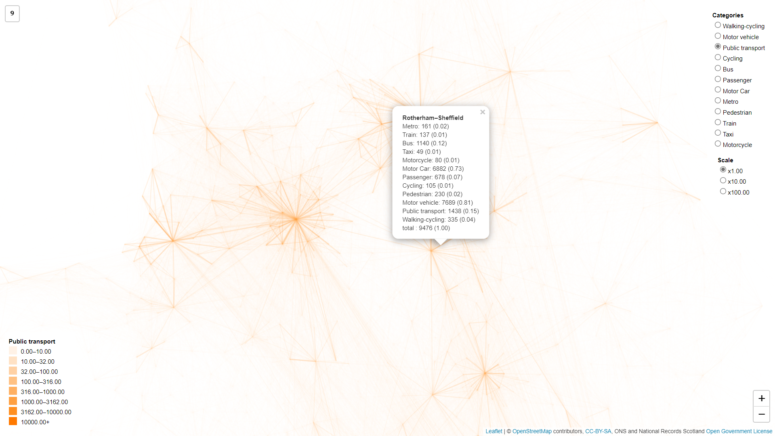
Notes:
Shout out to the #Network2050 posse
22

Slide 23
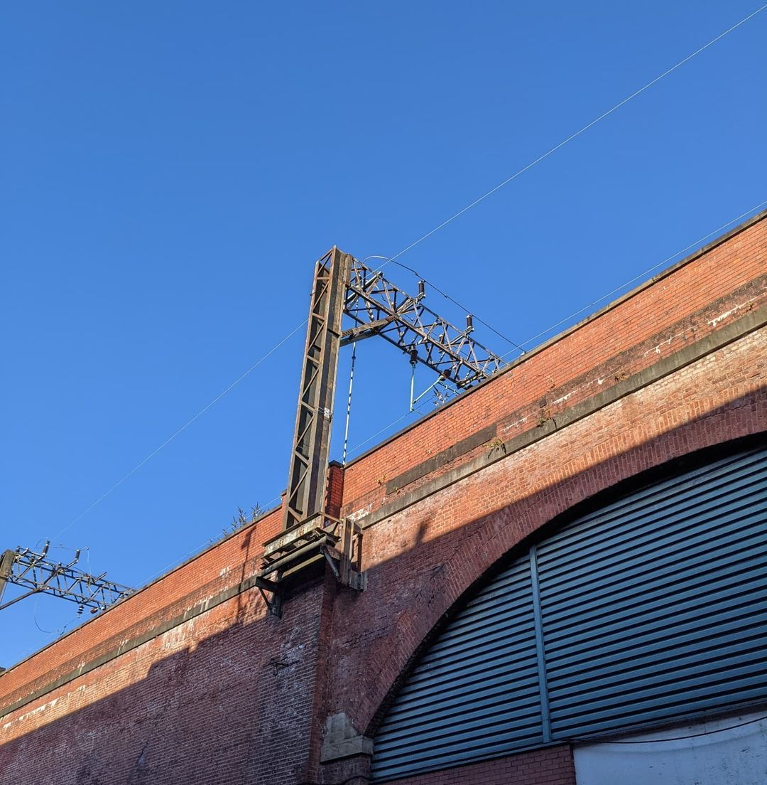
Rail Electrification
Notes:
23

Slide 24

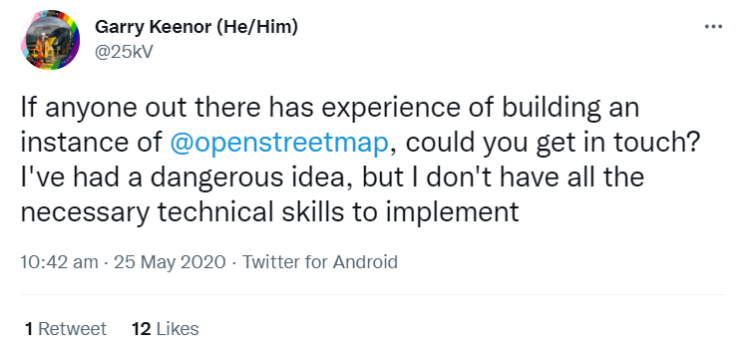
Rail Electrification
‘Once upon a time on a hot day in May 2020 amidst a pandemic lockdown, a rail engineer tweeted....’

Slide 25
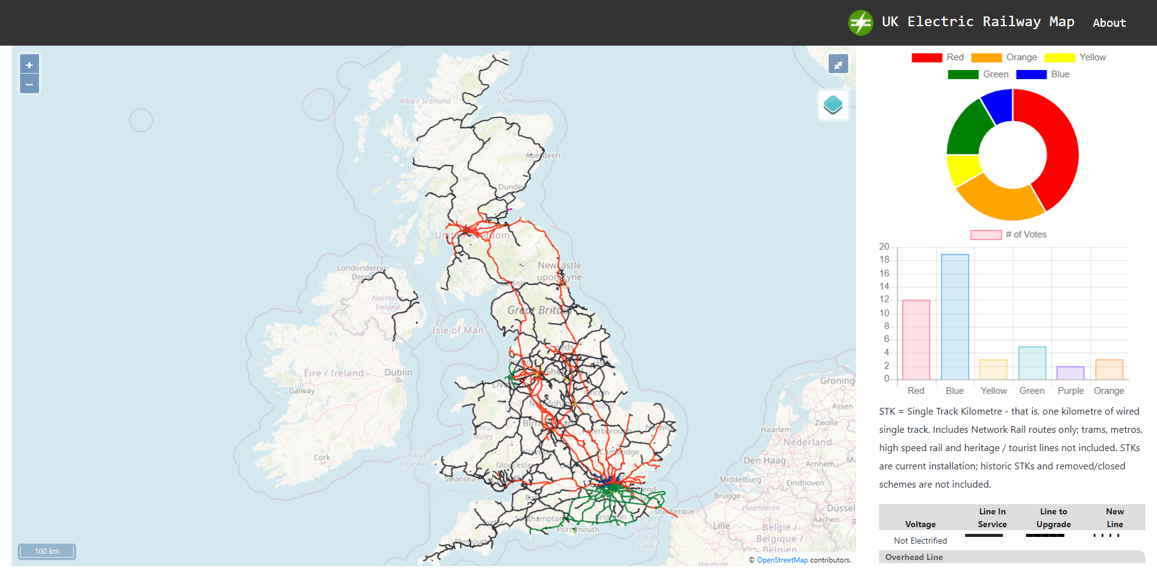
Rail Electrification

Slide 26
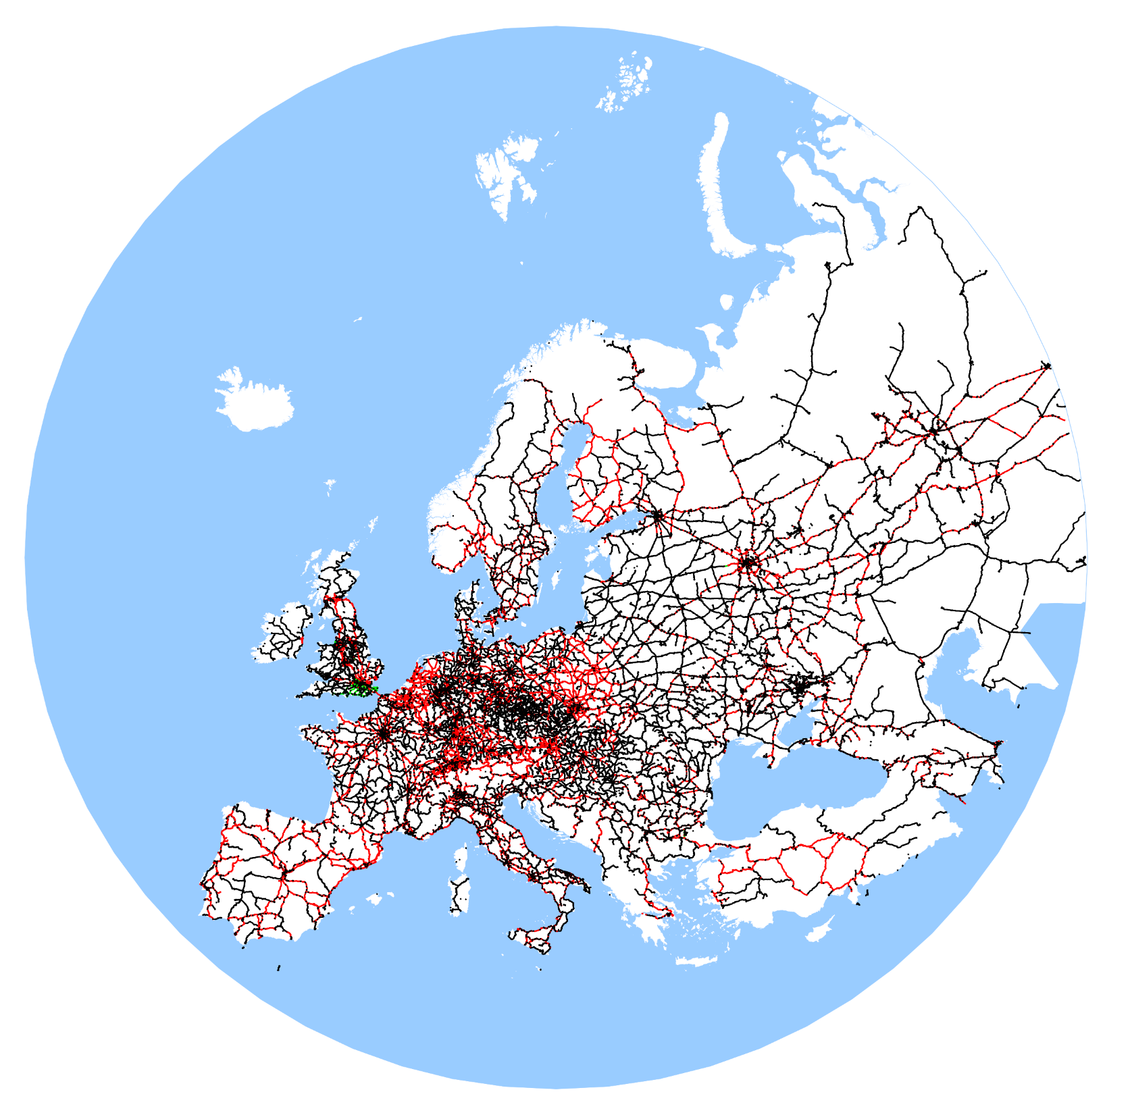
OSM
Rail Electrification
A rail map showing European electrification using Open Streetmap Data

Slide 27

Passenger
Flow

Slide 28
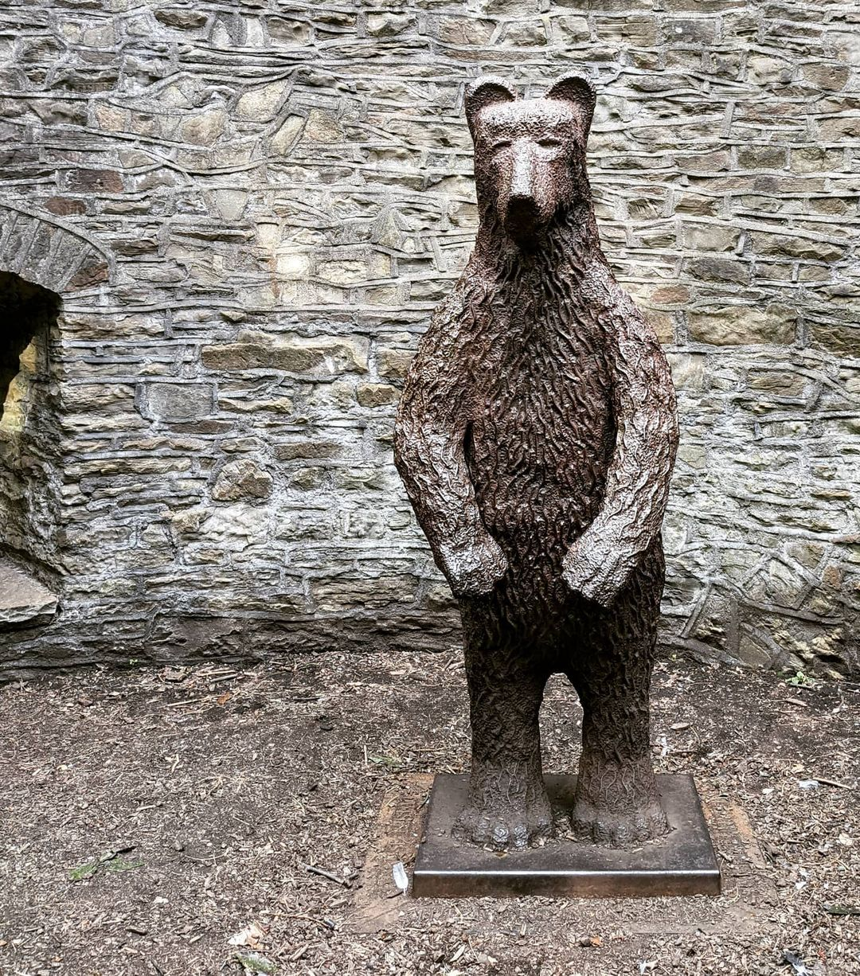
Origin and Destination
Matrix (ODM) Data
Notes:
It’s a bear
28

Slide 29
Distances
FoI centre-line track-model to find the shortest-path distance between ORR passenger-flow stations
How hard could it be?

Slide 30

Open Data
Notes:
Having fixed the network what about the trains?
30

Slide 31
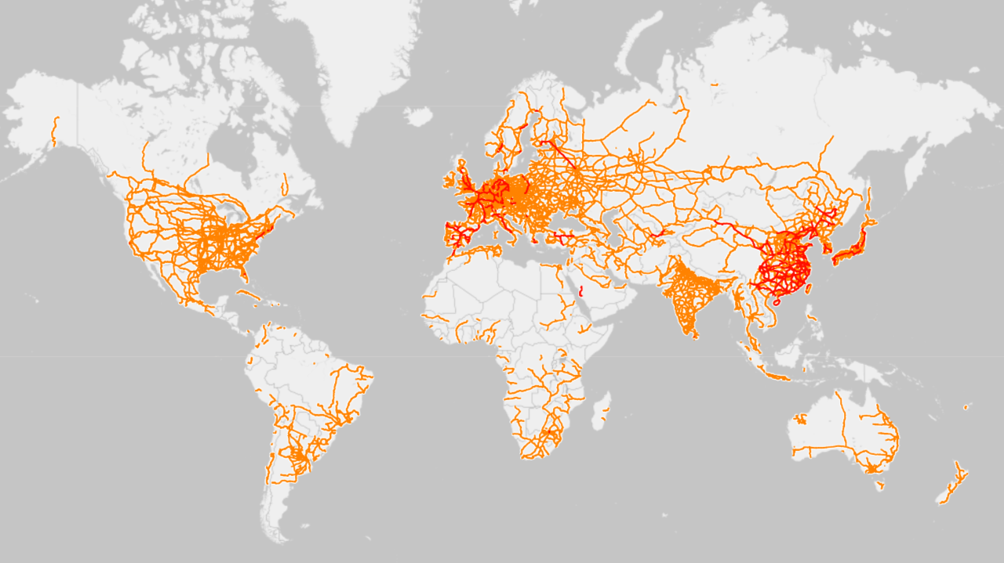
Railway Maps

Slide 32
Railway Maps

Slide 33
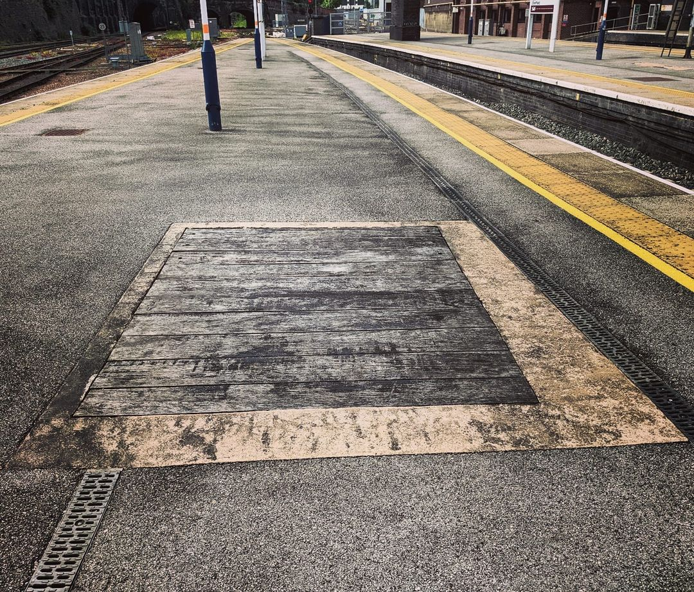
The Railway
Open Railway Map

Slide 34
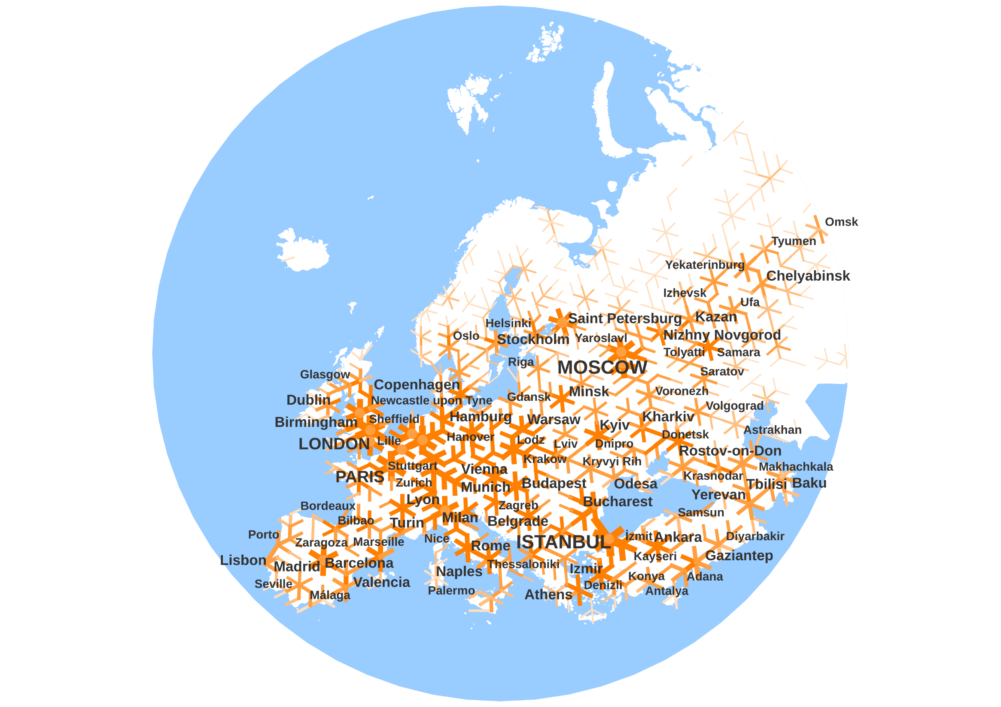
Labels
03 30

Slide 35
Freedom
of
Information
Notes:
Having fixed the network what about the trains?
35

Slide 36
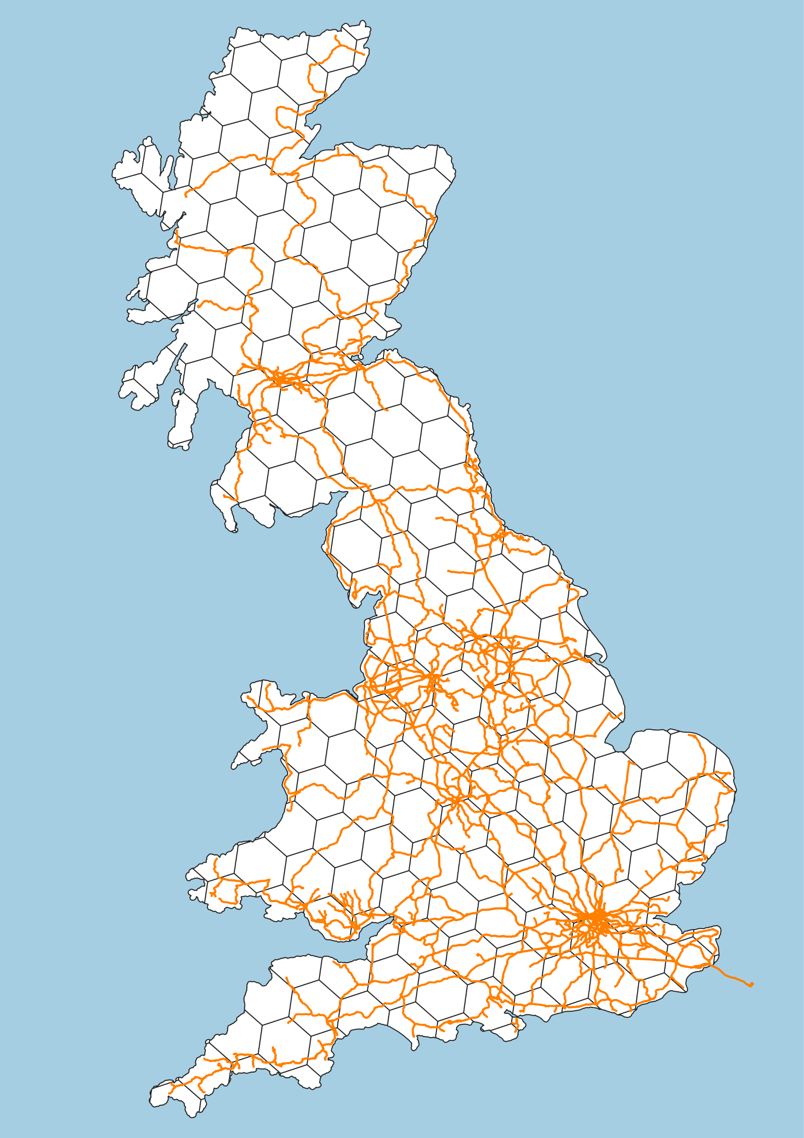
The Railway in Maps
The Freedom of Information (FoI) centre-line track-model

Slide 37
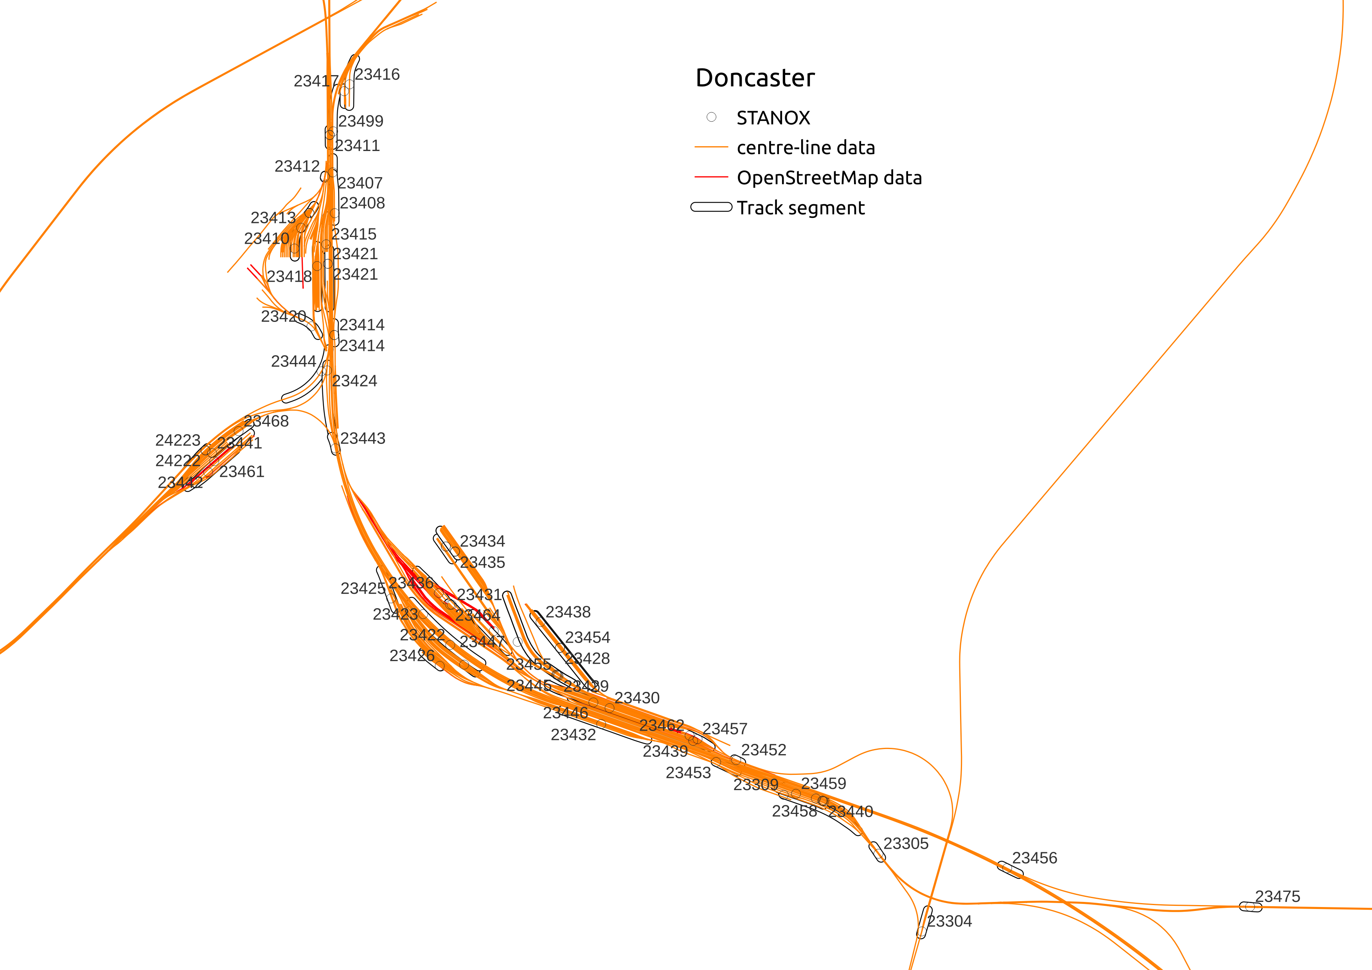

Slide 38
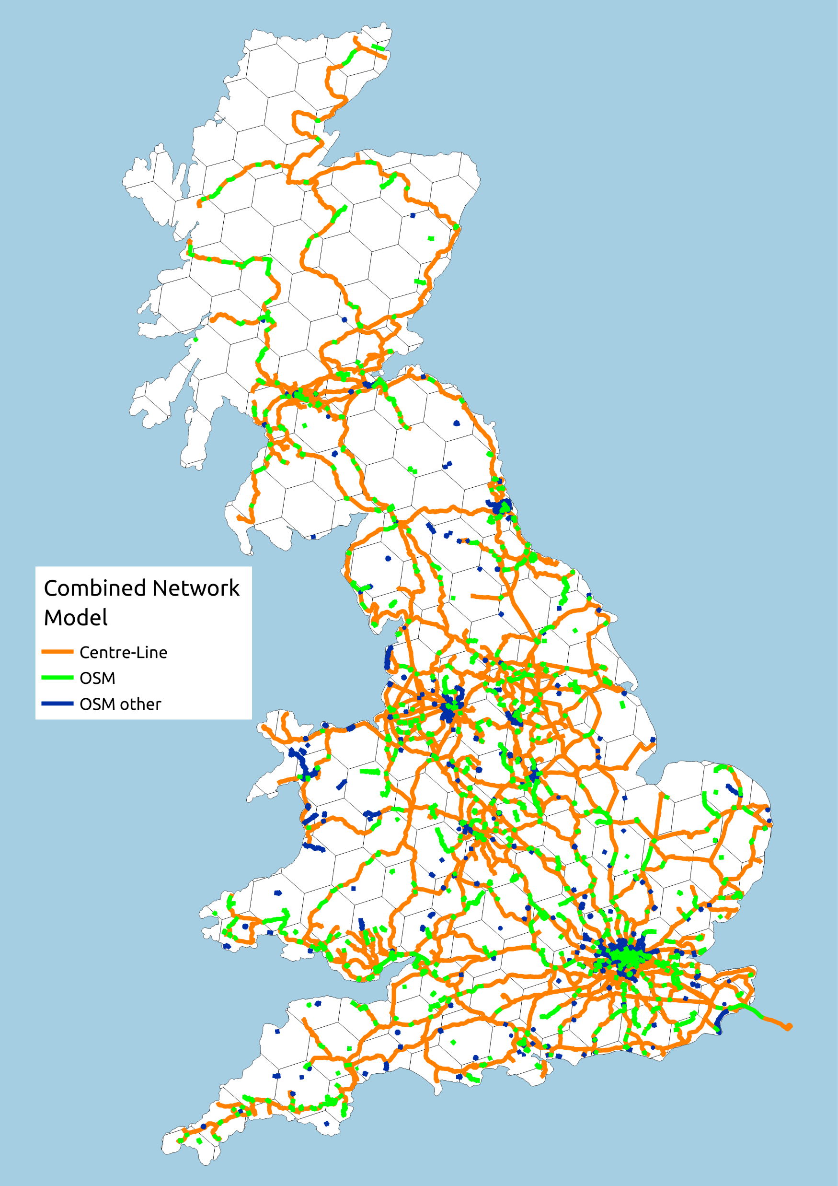
The Railway Compared
Centre-line track-model versus OpenStreetMap data

Slide 39
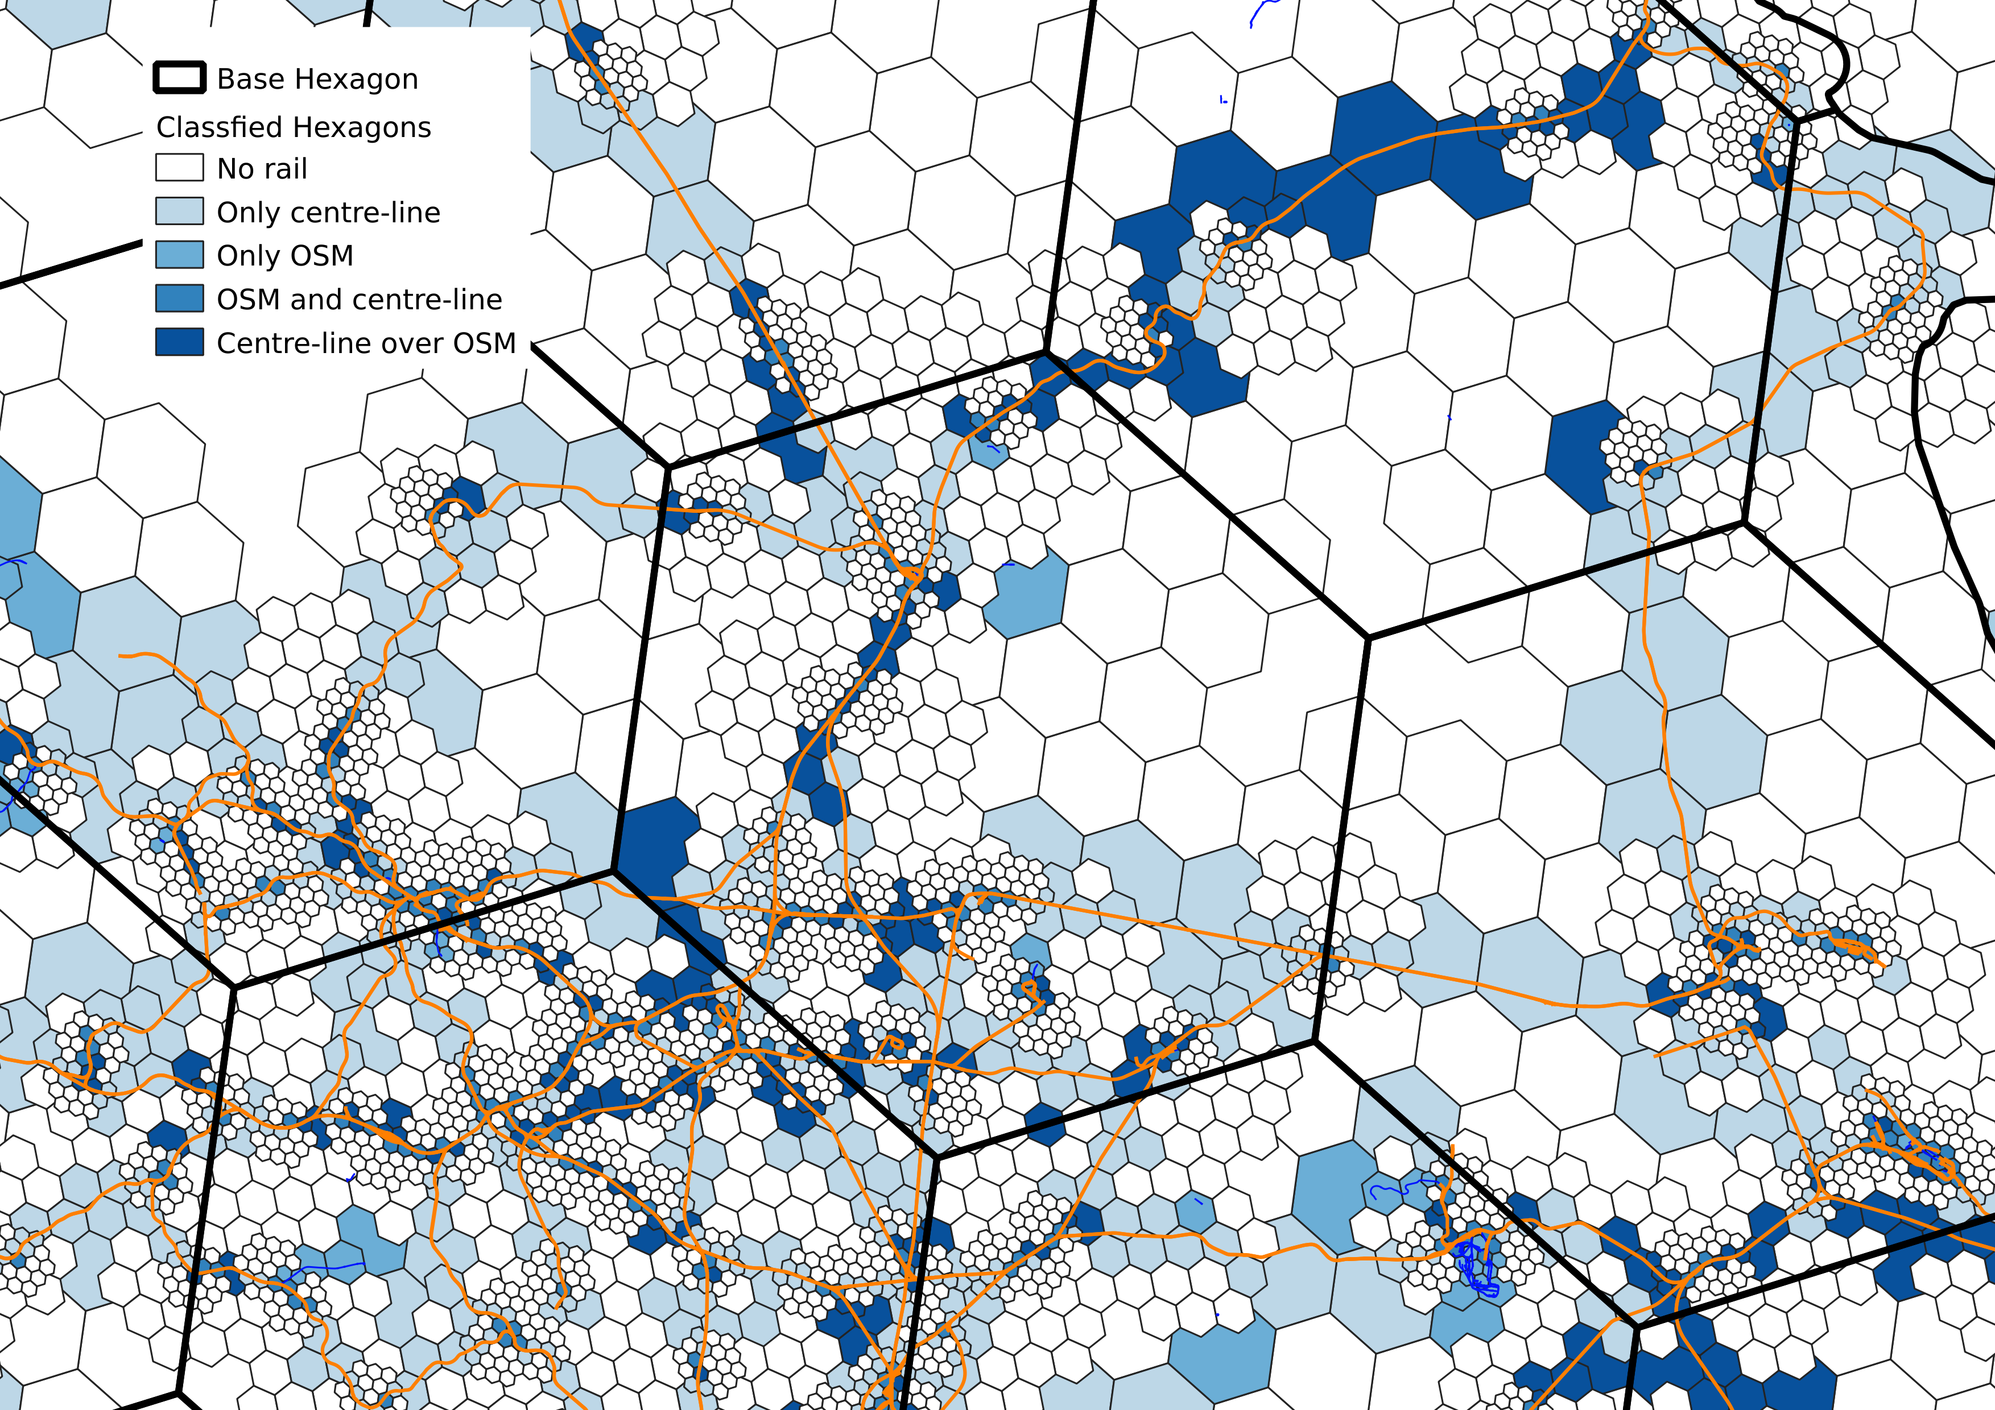

Slide 40

So it begins
Notes:
40

Slide 41
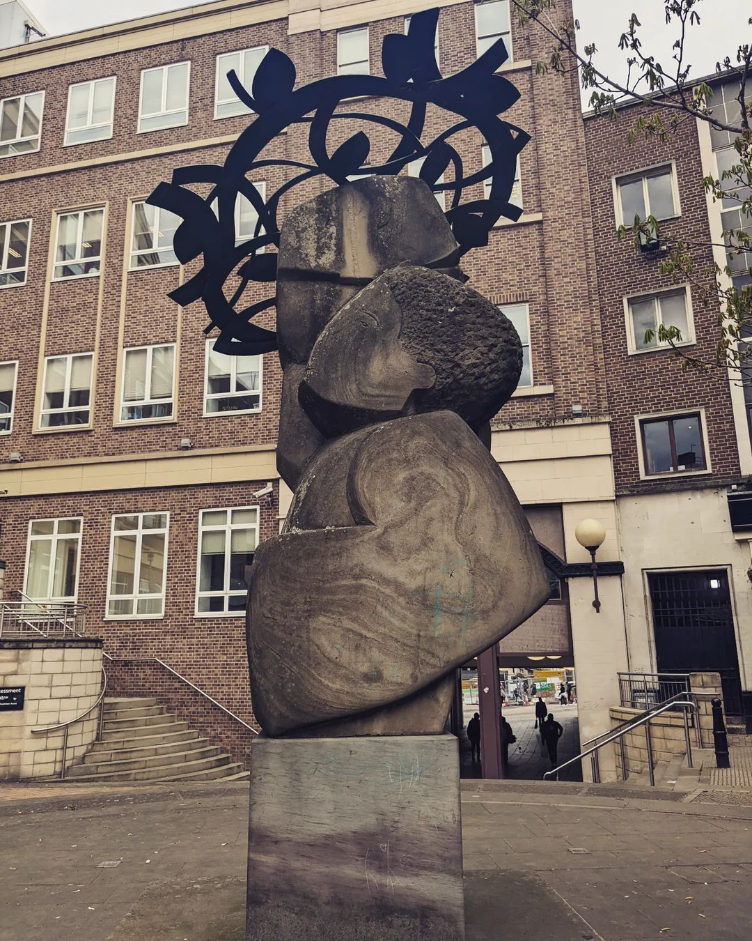
In Media Res?
Notes:
Having fixed the network what about the trains?
41

Slide 42
Distances
Use the FoI centre-line track-model to find the shortest-path distance between ORR passenger-flow stations
How hard could it be?

Slide 43
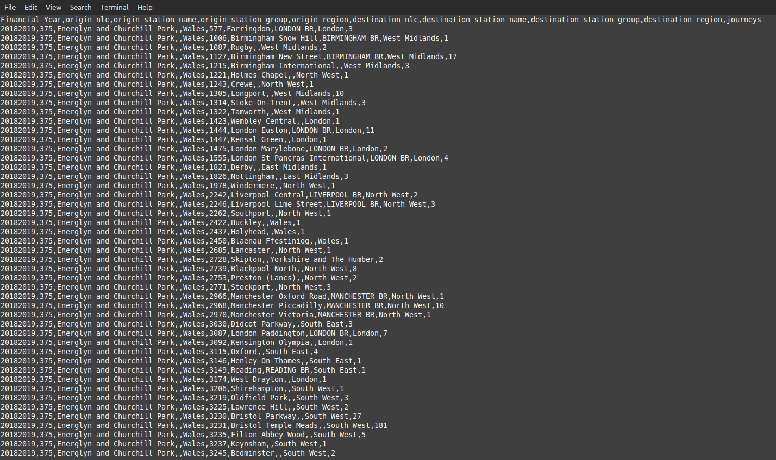
Passenger Origin Destination Matrix
Rail Data Market Place data set Financial Year 2018-19
1,534,186 line Comma Separated Variable (CSV) file
Origin and Destination by Computer Reservation System (CRS) code

Slide 44
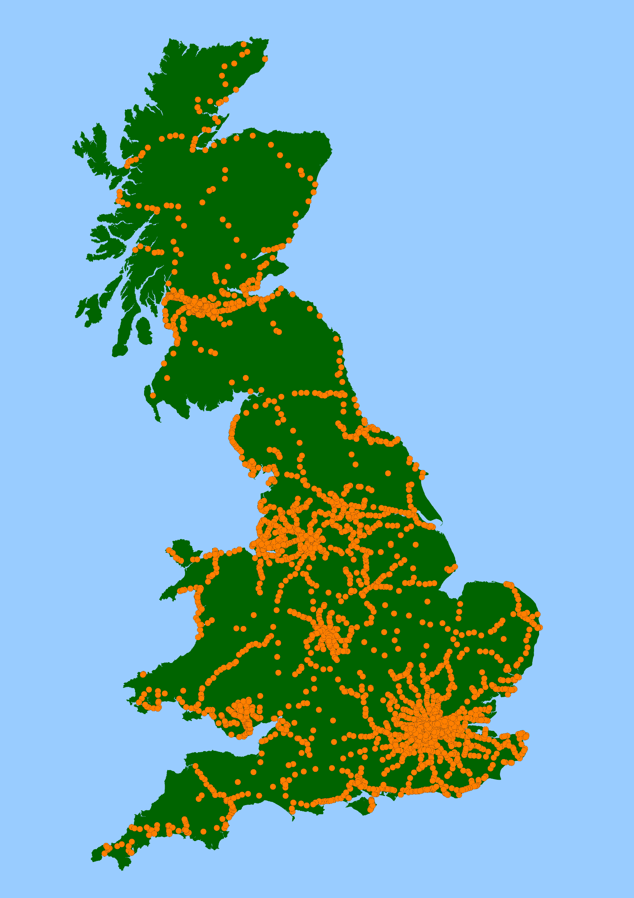
Wrinkles and Data Wrangling
Add station point locations
Use National Public Transport Access Network gazette (NaPTAN)
NaPTAN has Timing Point LOCations (TIPLOC) codes Map TIPLOC to CRS using CORPUS Network Rail open data
Fix the six wrong TIPLOCs matches
Use OpenStreetMap to find the four missing CRS

Slide 45
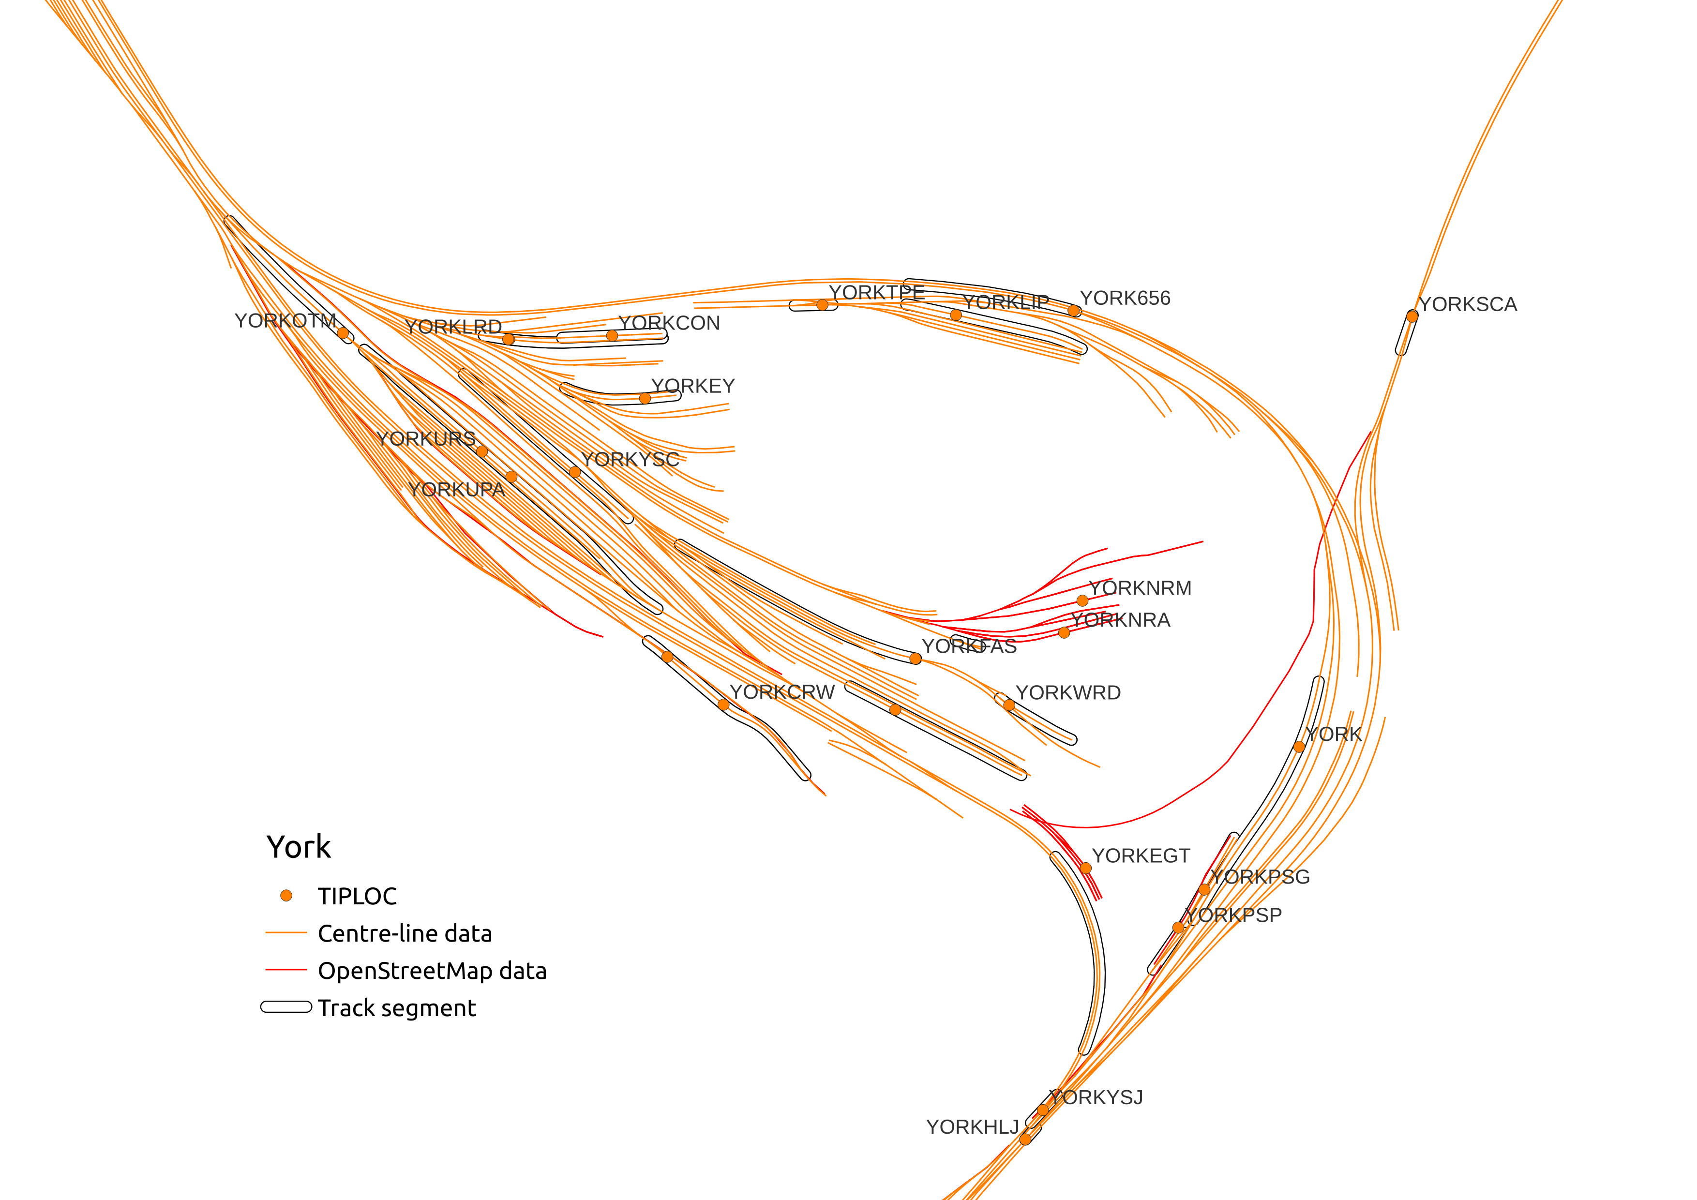
Wrinkles and Data Wrangling
Combine with the centre-line track-model
Simplify to remove simple connected links
Snap the station locations to track on the network model
Split the track at snapped station locations

Slide 46
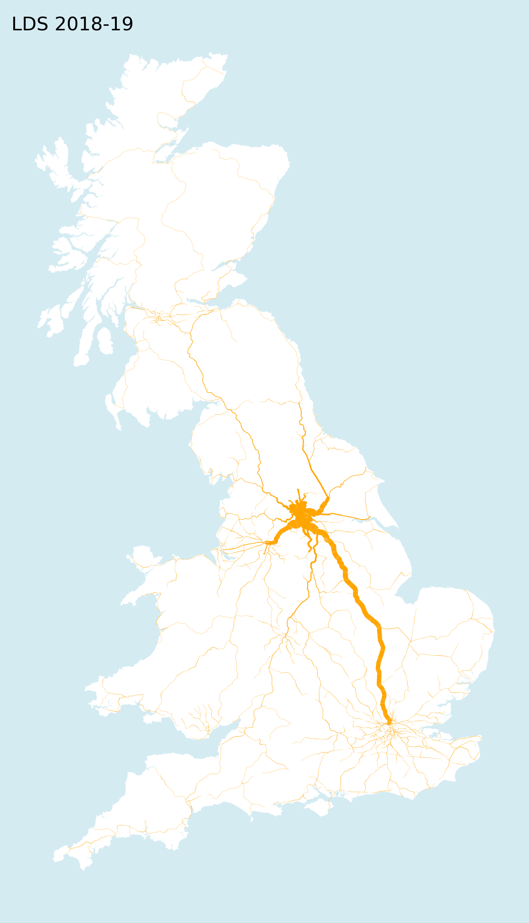
Distances Part Deux
For the 2,579 stations with CRS codes
The maximum path 1478.23km Wick and St Ives
Wick and Bodmin Parkway, 1396.26km and 23-hours
Dorchester over the Glenfinnan Viaduct takes 14-hours
Walk between
Southend Central and Southend Victoria
Dorking Deepdene and Dorking
Larbert to Shanklin commute is nine train changes and 10 hours plus a ferry trip

Slide 47
What I planned
Deliver a nation passenger flow for the 2018-2019 ORR dataset…

Slide 48
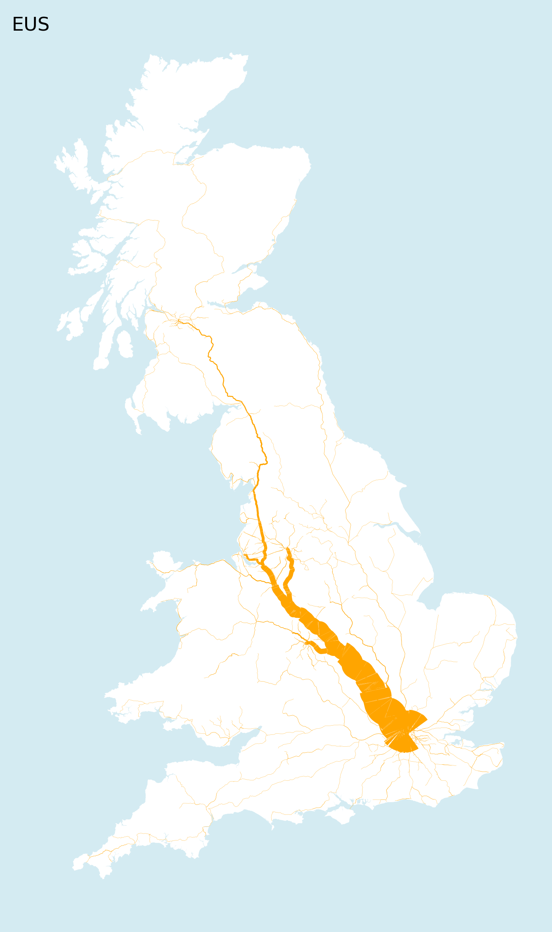
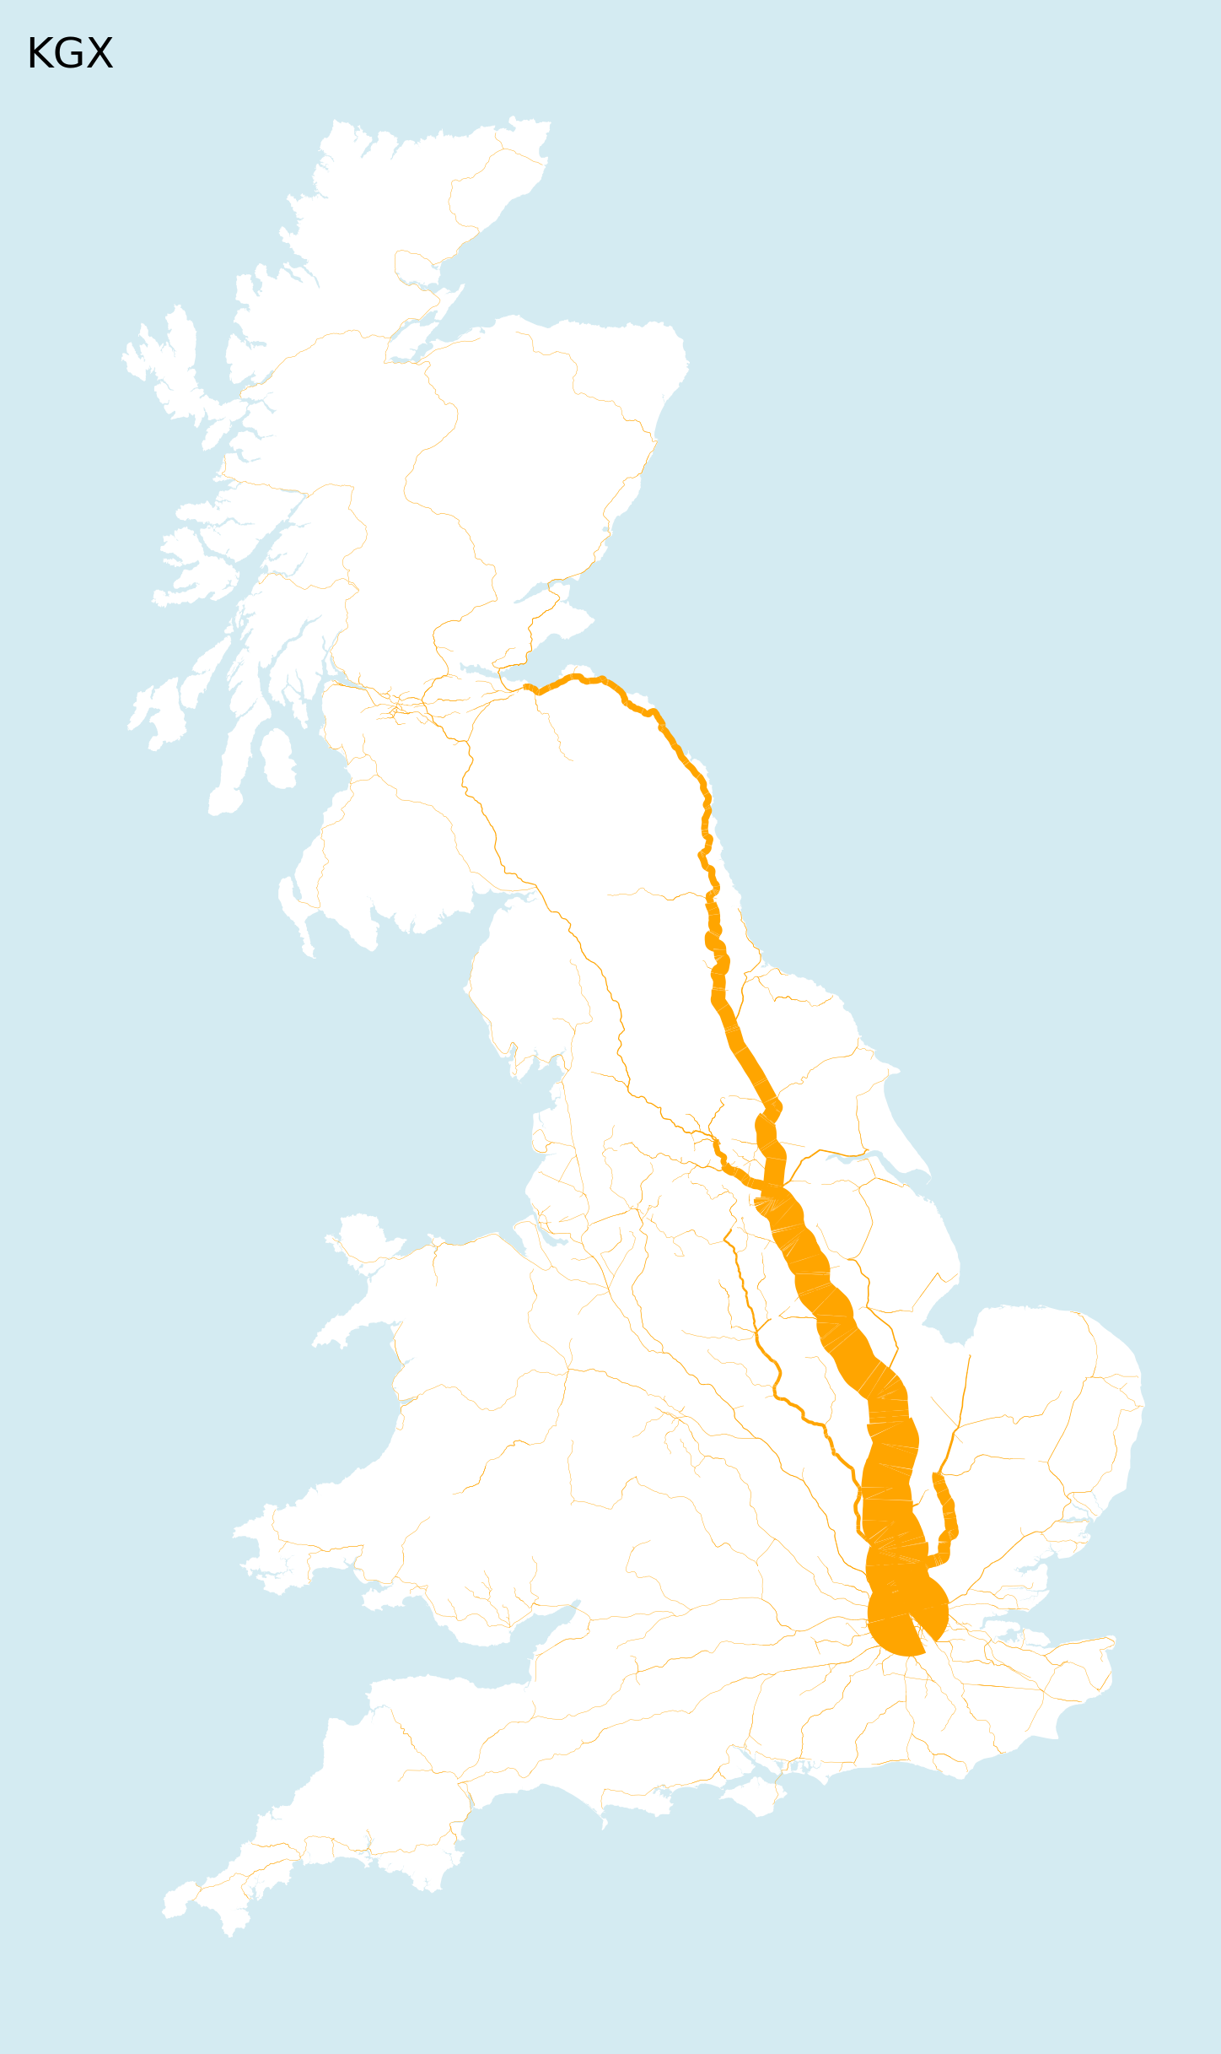
What I did
A passenger flow for each station in the 2018-2019 ORR data

Slide 49
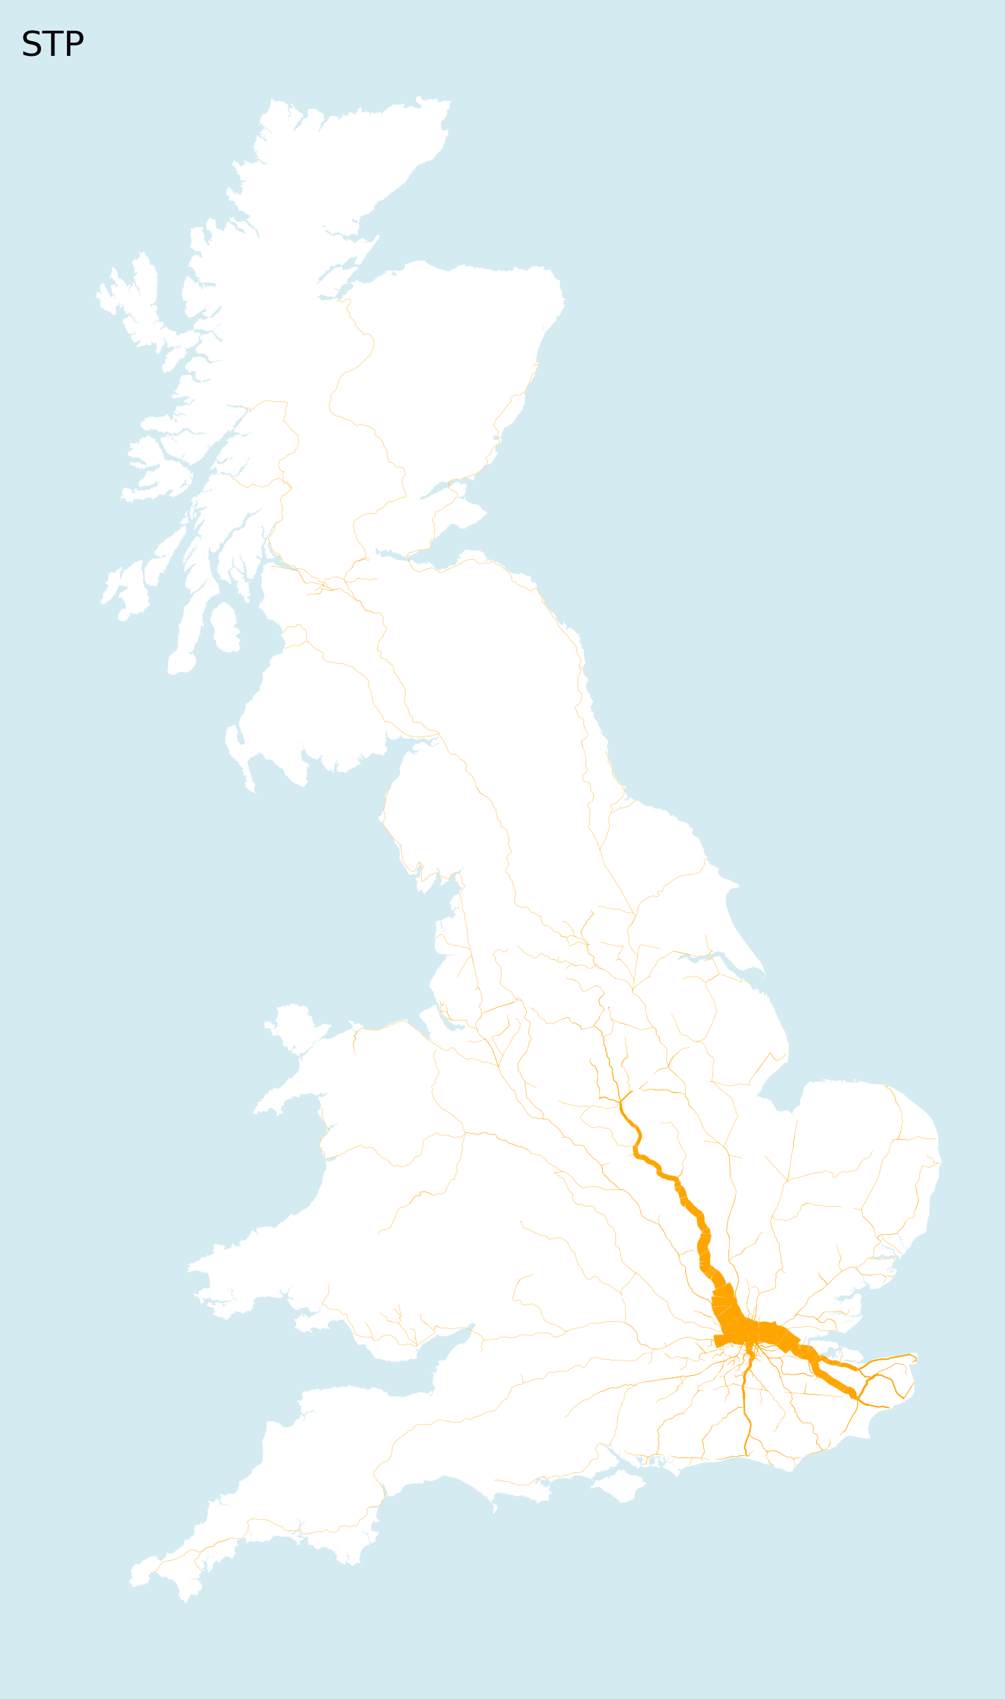
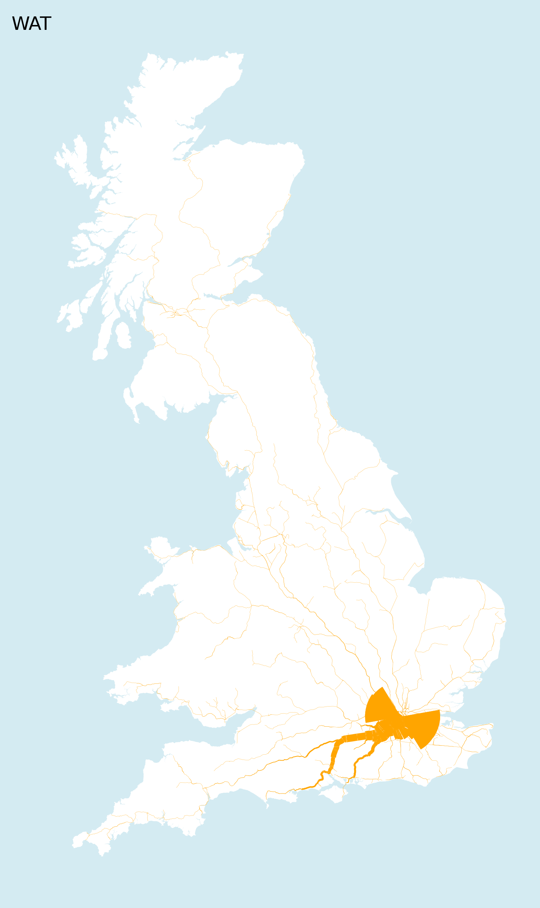
What I did
A passenger flow for each station in the 2018-2019 ORR data

Slide 50
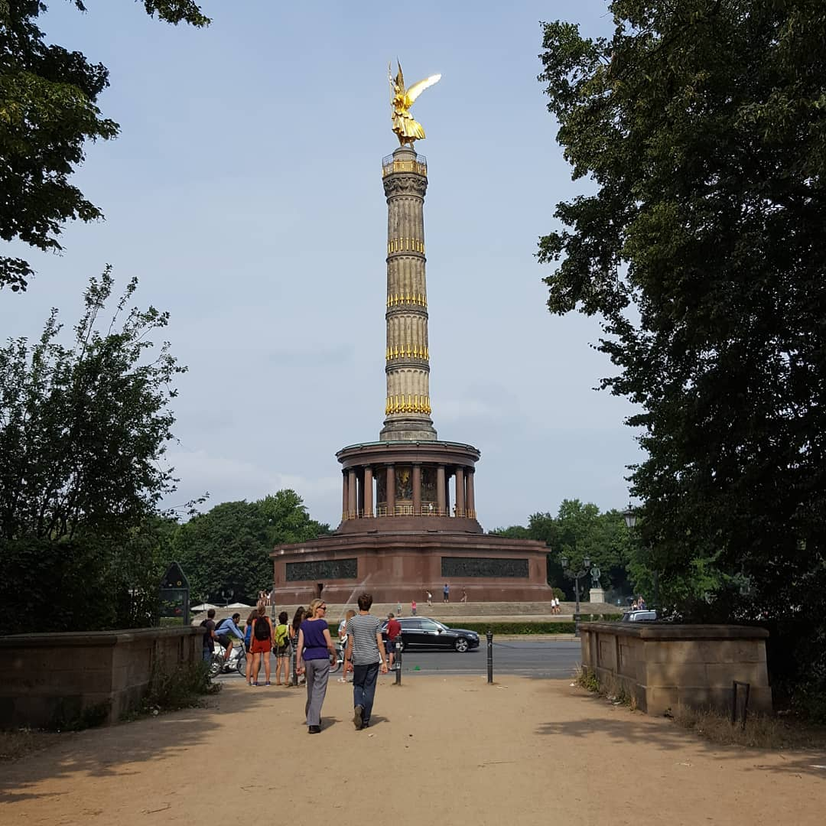
So what?
Notes:
50

Slide 51
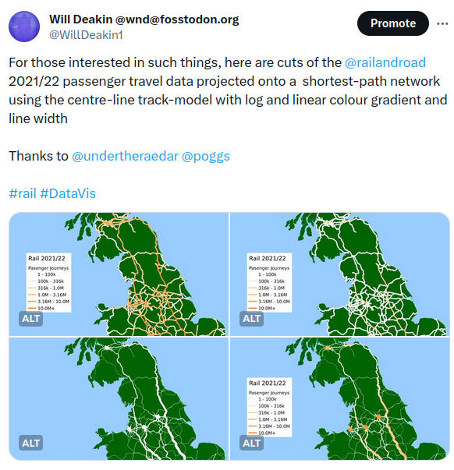
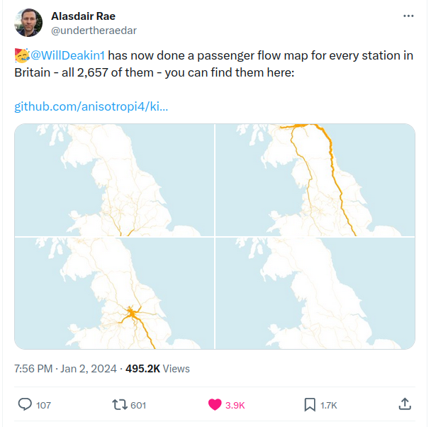
Social Media Redux

Slide 52

What Happened Next?!?
UX is very v important
Hosting Gremlins with GitHub
The Isle of Wight
Open Data

Slide 53

One
Column
Only
Notes:
Talked about the timetable
The constraints
What you might do about it
53

Slide 54
What Did People Think?
90 % amazing, wow, love it - unreal piece of work
5 % MY StATiON isNT ListED
3 % It’s all fake, this guy doesn’t know anything about trains
2 % Have you considered x, y, z approach that actually isn’t possible anyway?

Slide 55
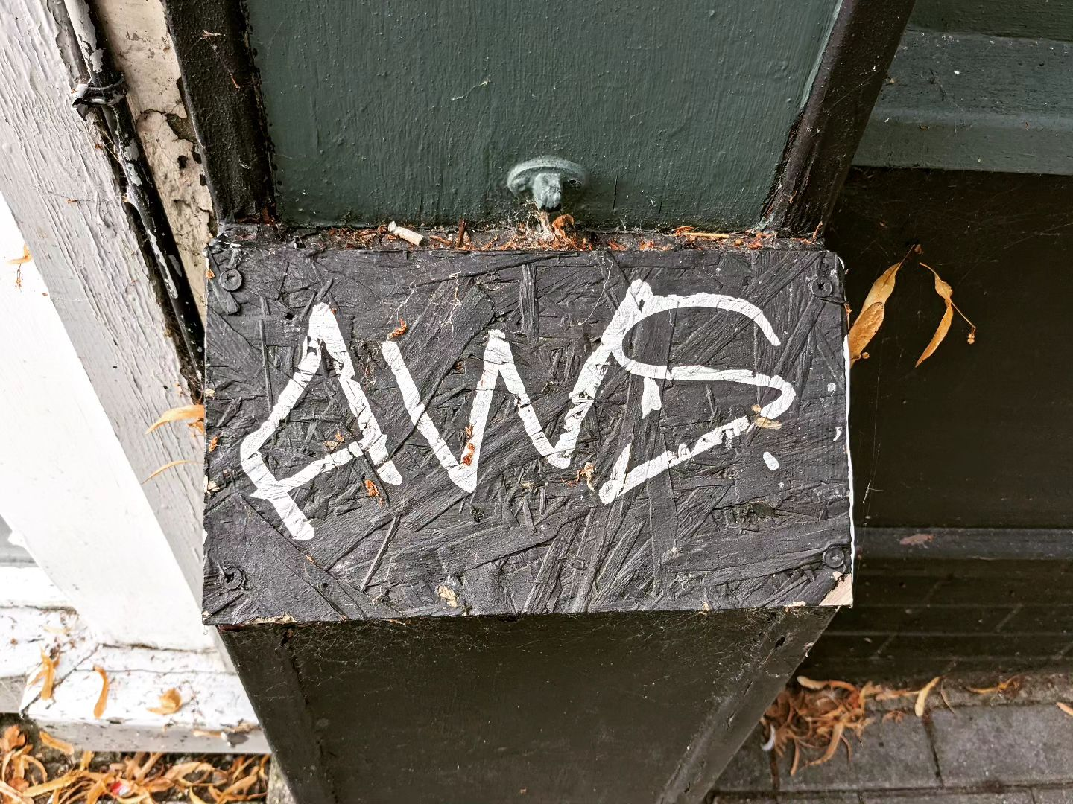
State of the Art
Cloud Hosting
Notes:
55

Slide 56
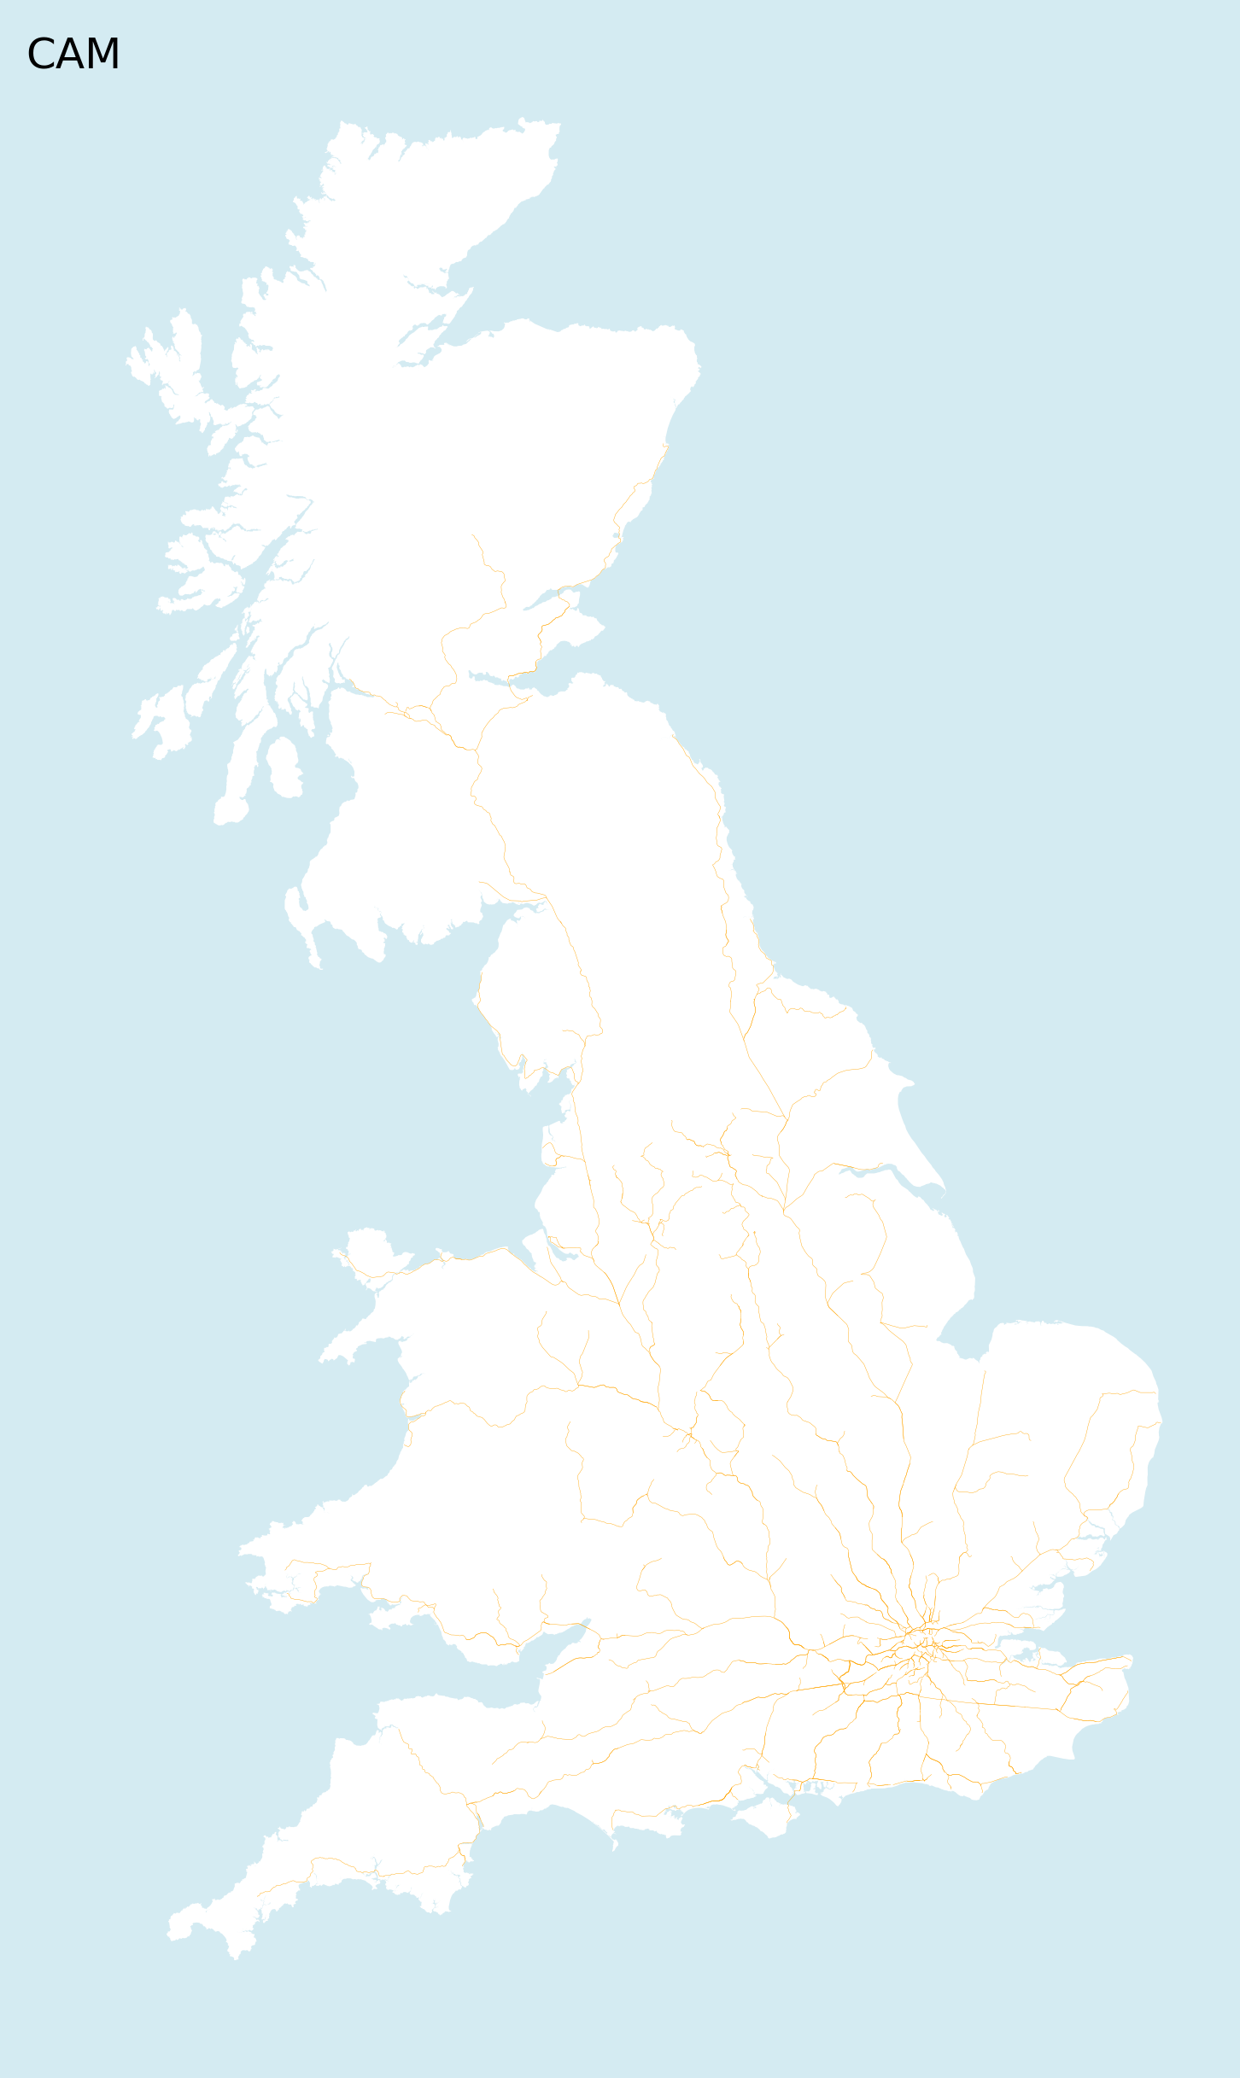

L’enfer c’est les autres

Slide 57

Open Data
Notes:
57

Slide 58
Open Data (Current attribution)
All data used on the basis that it under open or permissive license.
The base map of mainland Britain is derived from the WorldPop base maps under CC 4.0 by deed retrieved 2023-09-07.
The centre-line track-model is hosted by OpenRailData under the Open Government License by Network Rail, retrieved 2023-07-11.
The Origin Destination Matrix data, for example ODM 2022-23, were published by the Office of Road and Rail on the Rail Development Group Rail Data Marketplace, under the Open Government License. Retrieved 2024-02-18.
The Station Attributes for All-Mainline Stations published by the Office of Road and Rail under the Open Government License. Retrieved 2024-02-18.
The Network Rail CORPUS dataset is an open data feed which is released under a OGL. Retrieved 2023-11-29 as a local copy.
The National Public Transport Access Network NaPTAN under OGL and is updated each time the scripts are run.
While this implementation now uses NaPTAN and CORPUS to validate and identify six closed stations, the Isle of Wight ferry-link continues to use OpenStreetMap data, licensed under CC-BY-SA 2.0 through the OverPassAPI Turbo service, and is updated each time the scripts are run.

Slide 59
Shadows Appear
on the
Wall of a Cave
Notes:
59

Slide 60
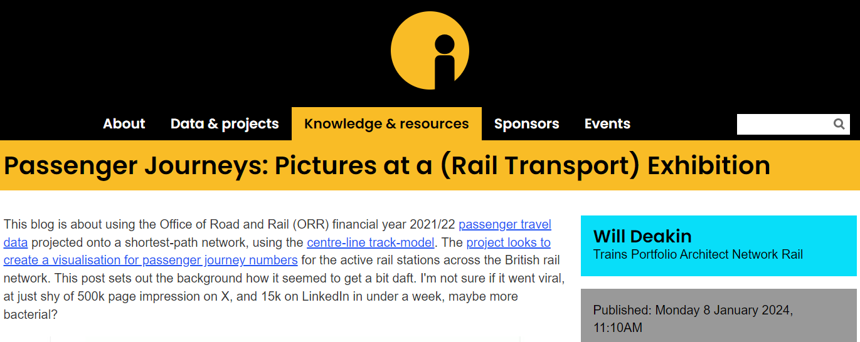
15 Seconds of Fame

Slide 61
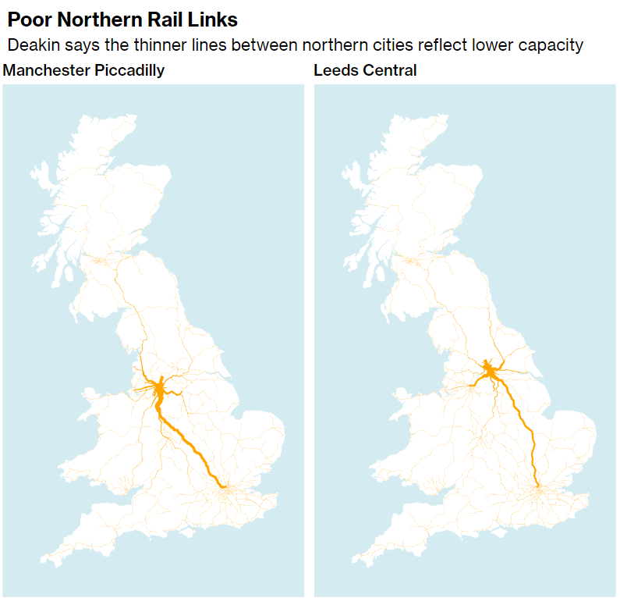
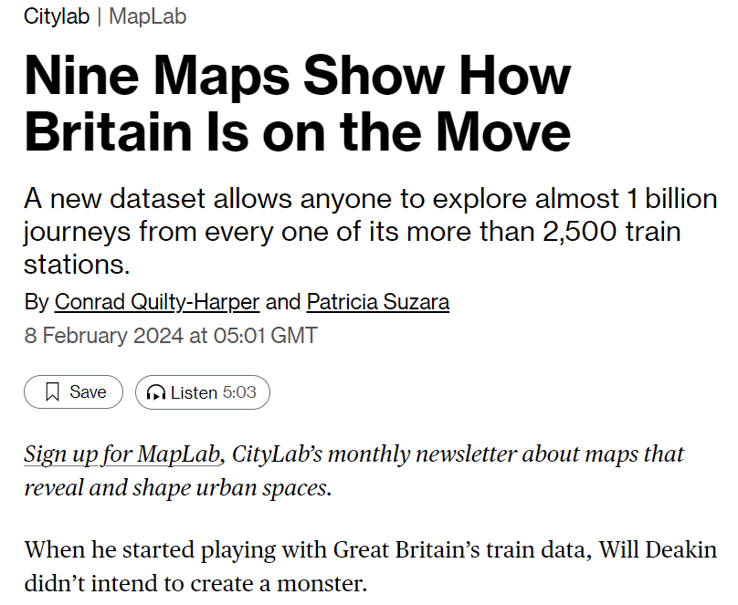
15 Seconds of Fame

Slide 62

Here Endth
the
First Lesson

Slide 63

What next?
Notes:
It’s important
It can help
It is unloved
63

Slide 64

More data
Notes:
64

Slide 65
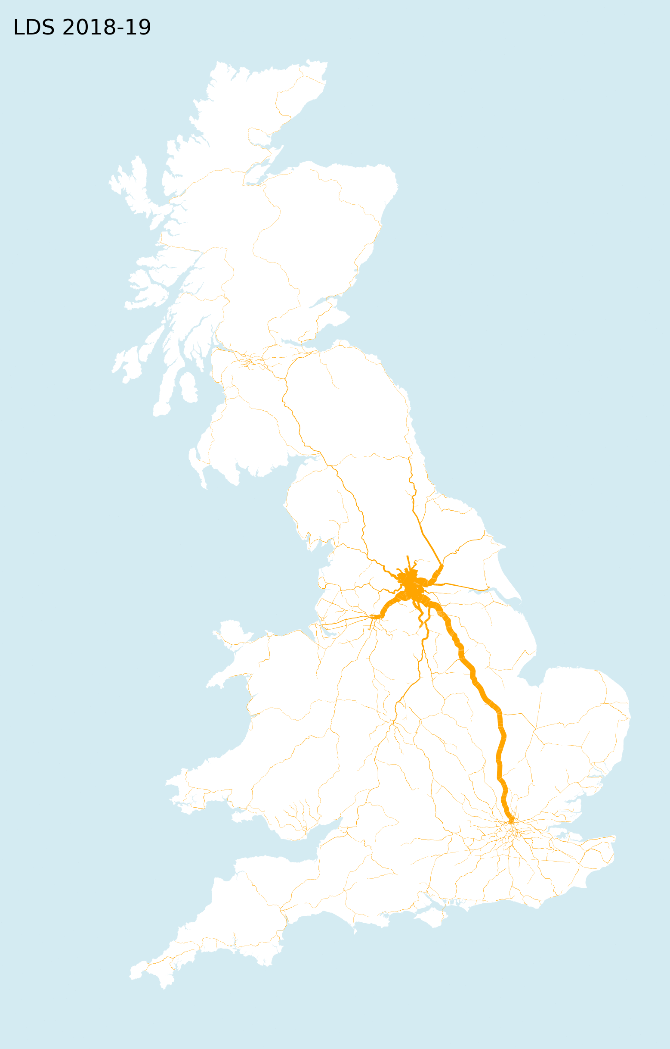
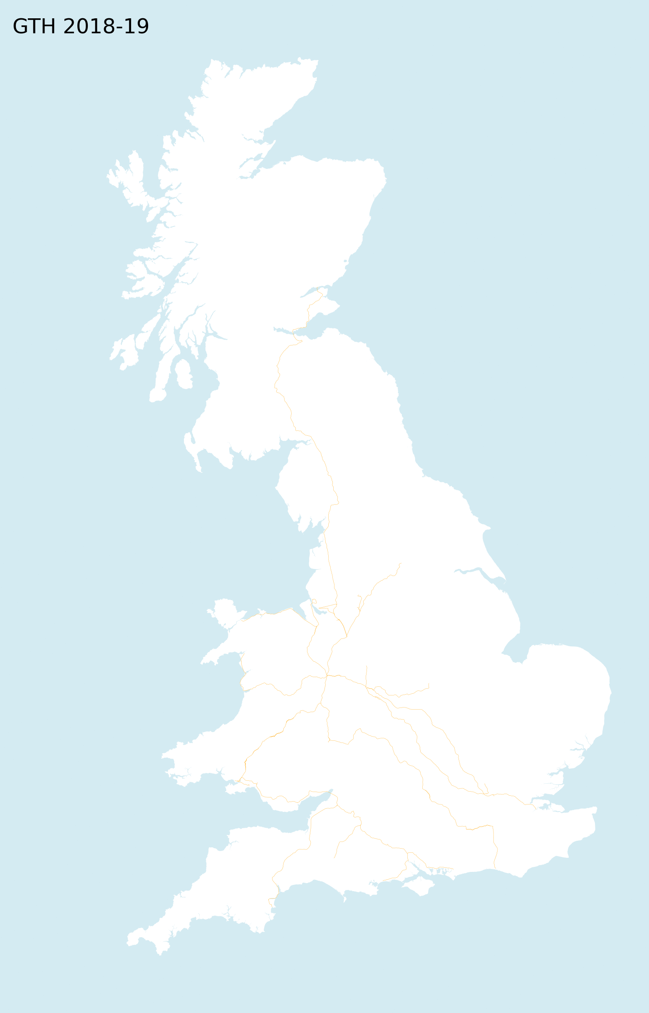
Passenger
Origin
Destination
Matrix

Slide 66
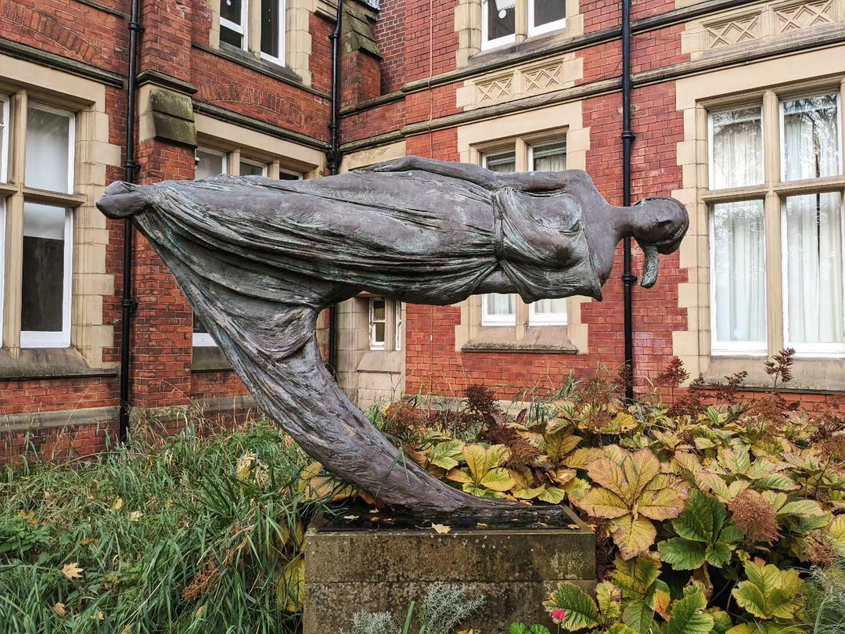
Delta View
Notes:
66

Slide 67
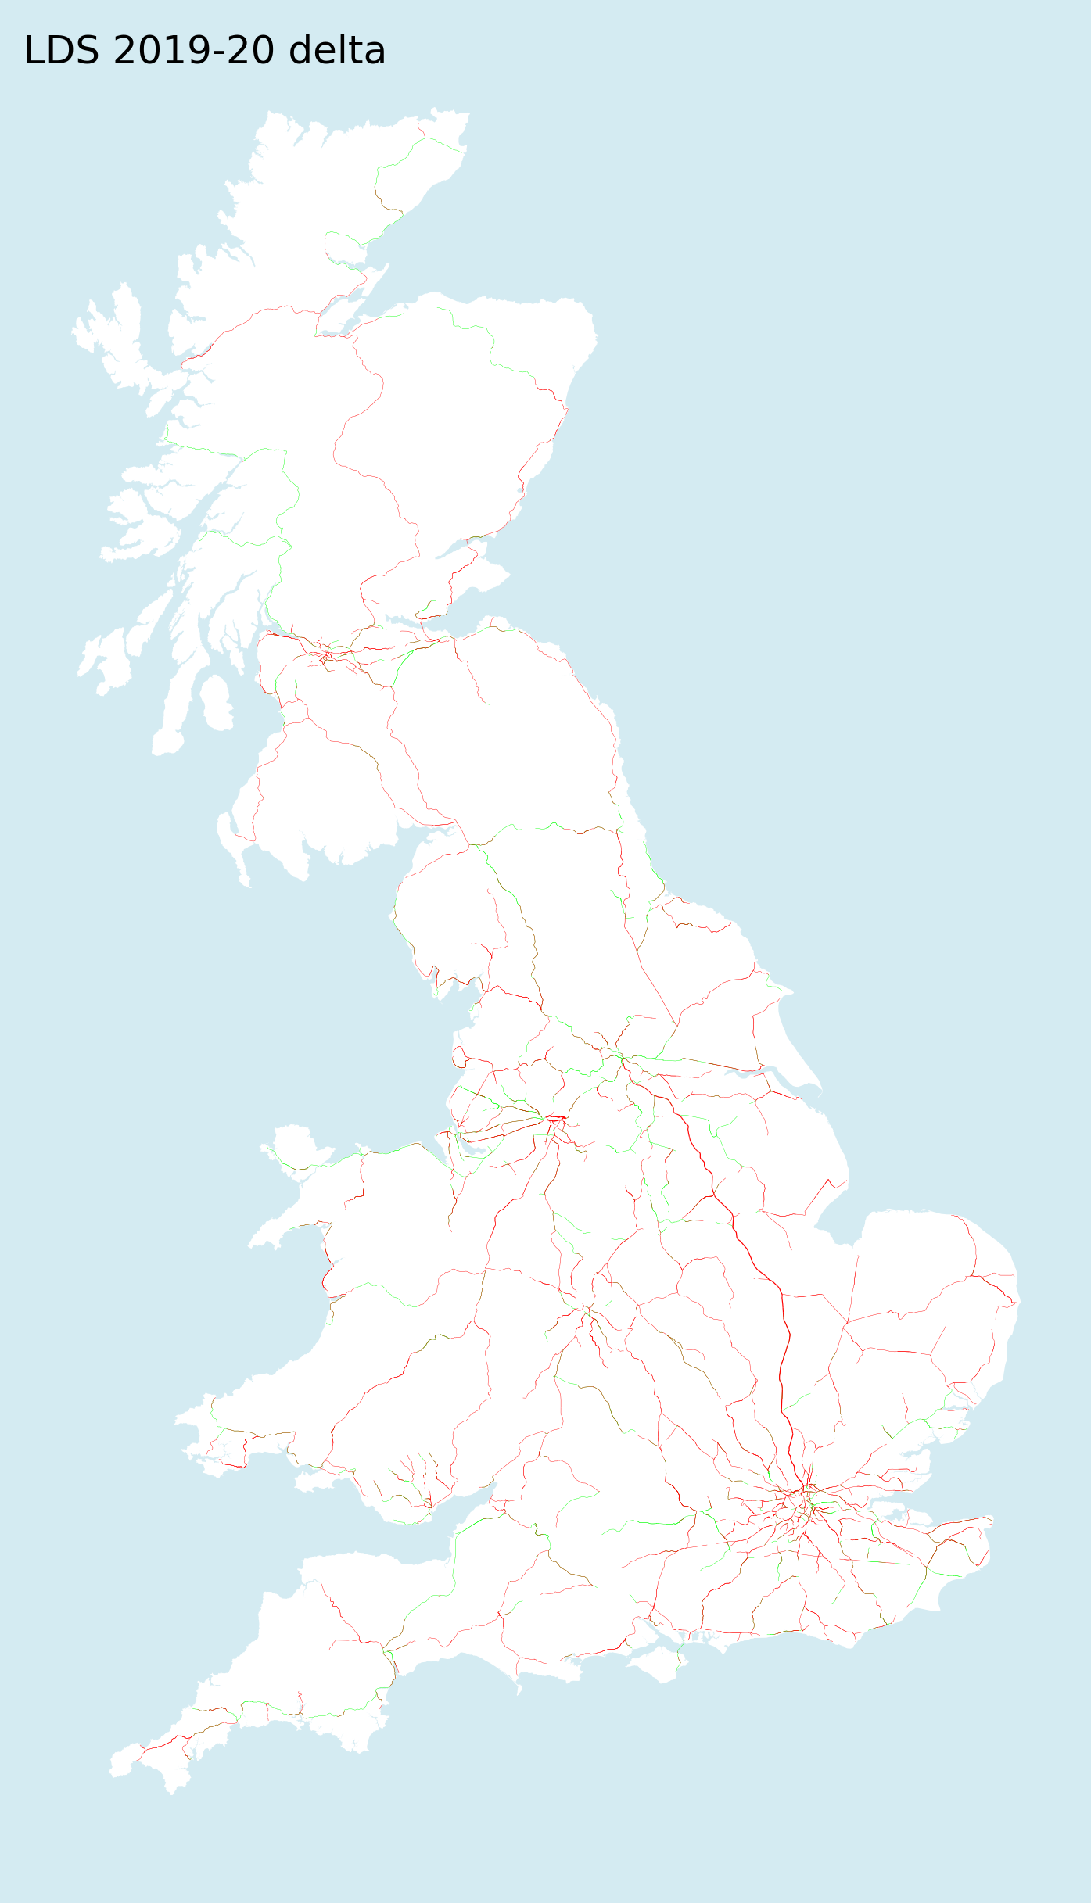
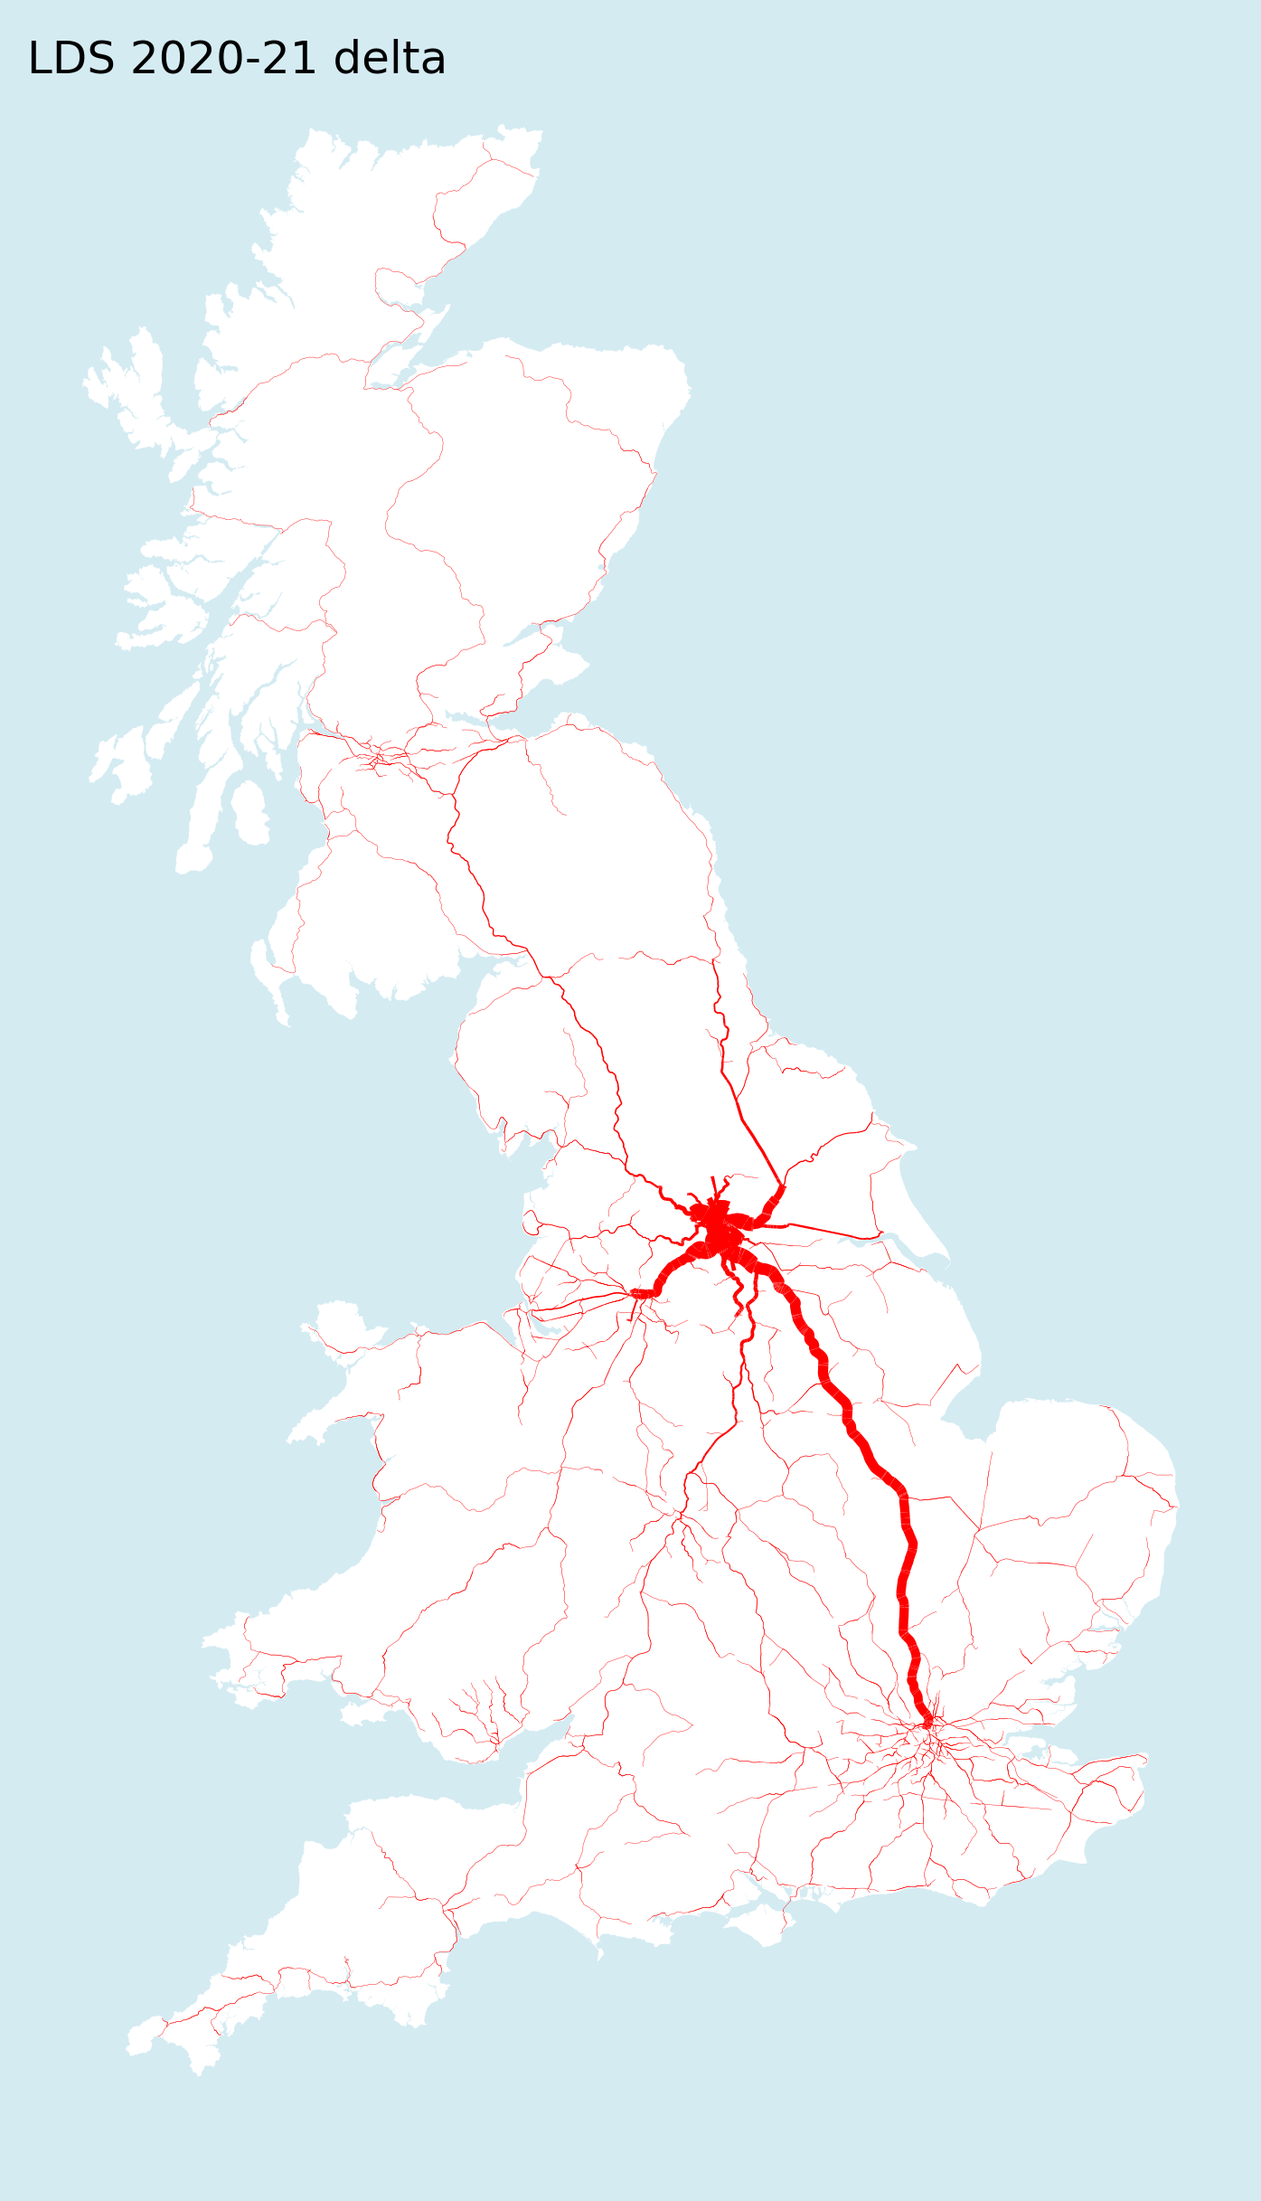
Passenger
Origin
Destination
Matrix

Slide 68

Passenger
Origin
Destination
Matrix

Slide 69


Passenger
Origin
Destination
Matrix

Slide 70

Passenger
Origin
Destination
Matrix

Slide 71

The then what?
More
Notes:
71

Slide 72

The Plan
Notes:
72

Slide 73

The
Railway
The Reshaping of British Railways
‘The Beeching Report’ 1963

Slide 74


The
Railway

Slide 75


The
Railway

Slide 76

The
Railway

Slide 77

The actual
Notes:
77

Slide 78


Gen X (Slacker Mode)

Slide 79

Post-Apocalypse
Notes:
79

Slide 80


More Social Media
Notes:
80

Slide 81


More Social Media
Notes:
81

Slide 82

Here Endth
the
Second Lesson
Notes:
82

Slide 83

Waving
not
drowning
Notes:
83

Slide 84

Work in progress
Notes:
84

Slide 85


ODM Machine
Learning
Population distribution
Rail passenger travel
H3 Grid 03 Scale 400

Slide 86
ODM Machine
Learning
Linear Regression
Rail passenger travel
H3 Grid 03 Scale 400
R2 0.794

Slide 87

ODM Machine
Learning
HGBR Regression
Rail passenger travel
H3 Grid 03 Scale 400
R2 0.761
Histogram Gradient Boosting Trees Regression

Slide 88


ODM Machine
Learning
Population distribution
Rail passenger travel
H3 Grid 04 Scale 141

Slide 89

ODM Machine
Learning
Linear Regression
Rail passenger travel
H3 Grid 04 Scale 141
R2 0.827

Slide 90
ODM Machine
Learning
HGBR Regression
Rail passenger travel
H3 Grid 03 Scale 400
R2 0.547
Histogram Gradient Boosting Trees Regression

Slide 91

Notes:
Simpler but when?

Slide 92

The then so what?
More
Notes:
92

Slide 93

Emissions
Emissions

Slide 94

UK CO₂ Emissions 1990-2020

Slide 95

UK CO₂ Emissions 1990-2020

Slide 96

UK CO₂ Emissions 1990-2020

Slide 97
An Integrated
Public Transport Strategy
Notes:
97

Slide 98

What about some High-Speed Rail?
Notes:
98

Slide 99

Is it enough?
Notes:
99

Slide 100

Questions and Answers
Notes:
100

Slide 101

Parting Words
Notes:
101

Slide 102

Build it and they will come!
Notes:
102

Slide 103

Incremental Change
Significant investment in rail will make a difference
Notes:
How the modal-shift should benefits C02 over road traffic
But this is political

Slide 104
The data is awesome...
‘Madame Helena, the timetable is the most perfect product of the human mind’
R.U.R.
Karel Capek
Notes:
104

Slide 105

...but it’s all Greek to me
μῆνιν ἄειδε θεὰ Πηληϊάδεω Ἀχιλῆος
οὐλομένην, ἣ μυρί᾽ Ἀχαιοῖς ἄλγε᾽ ἔθηκε,
πολλὰς δ᾽ ἰφθίμους ψυχὰς Ἄϊδι προΐαψεν
ἡρώων, αὐτοὺς δὲ ἑλώρια τεῦχε κύνεσσιν
οἰωνοῖσί τε πᾶσι, Διὸς δ᾽ ἐτελείετο βουλή, ἐξ οὗ δὴ τὰ πρῶτα διαστήτην ἐρίσαντε
Ἀτρεΐδης τε ἄναξ ἀνδρῶν καὶ δῖος Ἀχιλλεύς
The Iliad book 1 - Homer
Notes:
105

Slide 106
What about some High-Speed Rail?
Notes:
106

Slide 107

The big
BUT
Notes:
107

Slide 108
Is it enough?
Notes:
108

Slide 109

Thank You
Will Deakin
@wnd@fosstodon.org
X/Twitter @WillDeakin1
Notes:
109

Slide 110


Slide 111

Technology
Tools
github.com
gist.github.com
bl.ocks.org
d3js.org
python.org
gdal.org
leaflet.js
./jq
nodejs.org
Tesseract-OCR
MapBox tippecanoe
arangodb.com
postgresql.org
tabula.technology
tesseract-OCR
solr.apache.org
qgis.org
gdal.org
python Pandas
python GeoPandas
python osmnx

Slide 112
Reference
Wikipedia, International Klein Blue (#002FA7), here
Rail Alphabet, description and download, here
SPSmiler, “London Underground Tube”, here
Homer, Iliad, Perseus Digital Library here, accessed 4 May 2022
Transport Statistics Department for Transport, here
Department for Business, Energy & Industry Strategy, here
Open Rail Data wiki, here
Rail Development Group “Concept of Operations – Stock and Crew System” (RDG-CONOPS/NTI/002 Issue 1.1) January 2021 here
National Electronic Sectional Appendix (NESA) here
NESA table extract here
Notes:
112

Slide 113
Reference
Public Transport Travel choropleth data, here
Census travel flow within MSOA, here
Census travel flow between MSOA, here
Department for Transport “Great British Railways: Williams-Shapps plan for rail”, here
UK Electrification map, here
Geof Sheppard Class 70, here
Railway Industry Association “Why Rail Electrification”, 2021, here
European Agency for Railways “Fostering Rail Through Green Deal – part 2 Freight”, 2021, here
RailNet Europe, “Timetabling and Capacity Redesign (TTR)”, 2022, here
Network Rail, “Rail freight forecasts Scenarios for 2033-34 and 2043-44”, 2016, here
Notes:
113

Slide 114
Postscript
‘It is better to ask some of the questions that to know all of the answers’
- James Thurber
My thanks go to Alisdair Rae, Peter Hicks, Stuart Lowe, Gareth Dennis, Xander Veitch, Garry Keenor, and my ever and long-suffering family, all friends, colleagues and contributors to all the projects I have wilfully used for their help, support and advice
Notes:
114

Slide 115
Copyright 2024 Will Deakin
Licensed under the Apache License, Version 2.0 (the ‘License’);
you may not use this file except in compliance with the License.
You may obtain a copy of the License at
http://www.apache.org/licenses/LICENSE-2.0
Unless required by applicable law or agreed to in writing, software
distributed under the License is distributed on an ‘AS IS’ BASIS,
WITHOUT WARRANTIES OR CONDITIONS OF ANY KIND, either express or implied.
See the License for the specific language governing permissions and
limitations under the License.
Notes:
115

